Slide 1
“To Tea, or Not to Tea”
Brandon Thong & Dawn Layman

Slide 2
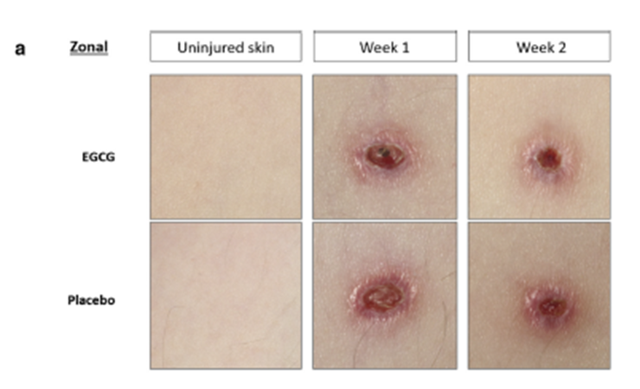

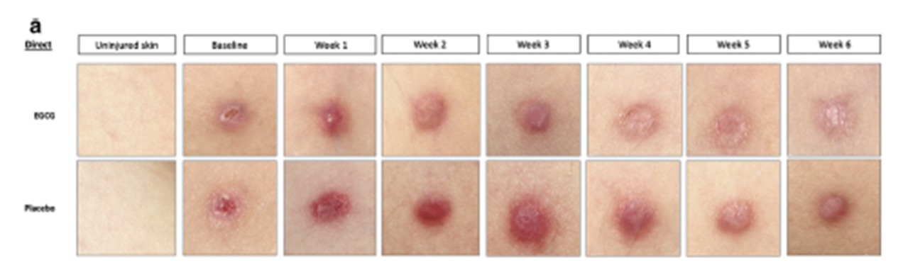
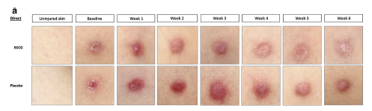
Project Background - Experiment
Zonal Priming:
Application of treatment surrounding wound immediately upon injury
Direct to Scar:
Wait till healing is complete, scar is formed and apply treatment direct to scar

Slide 3
Pre-Processing

Slide 4
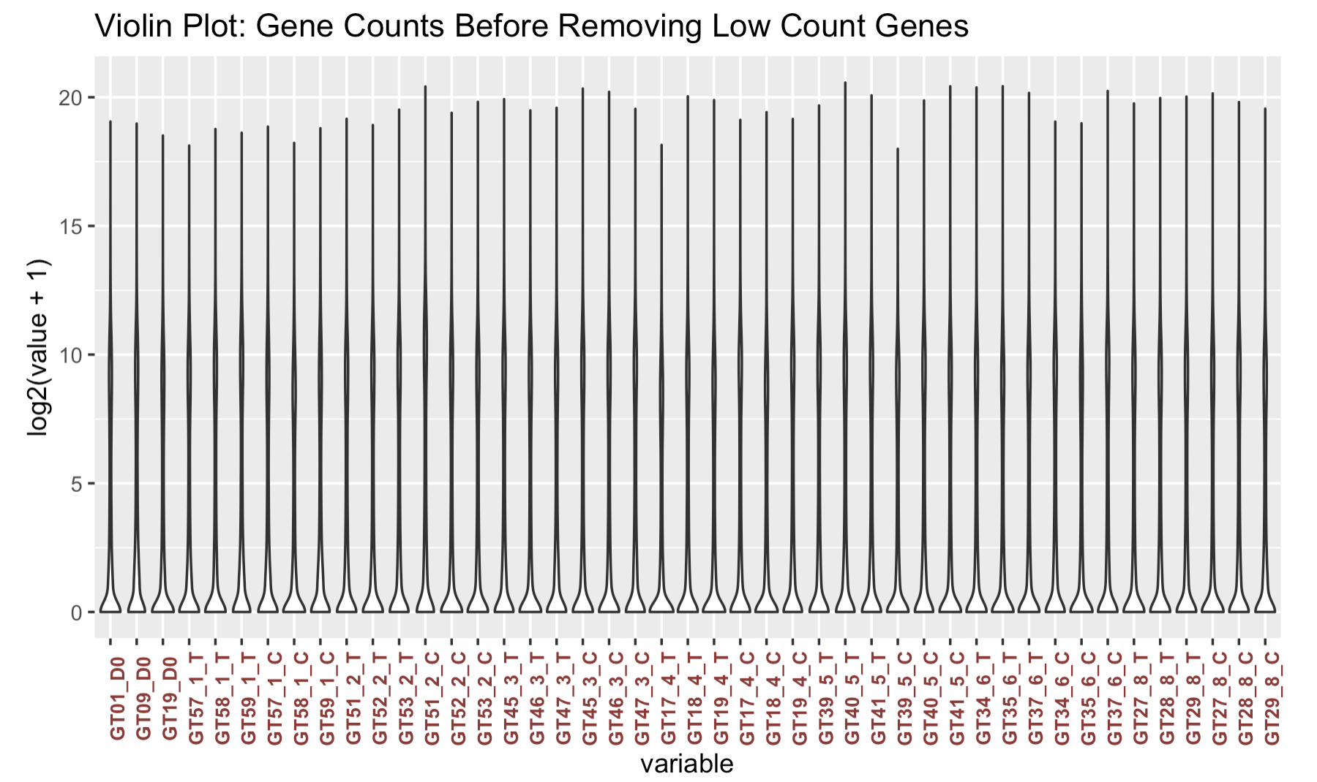
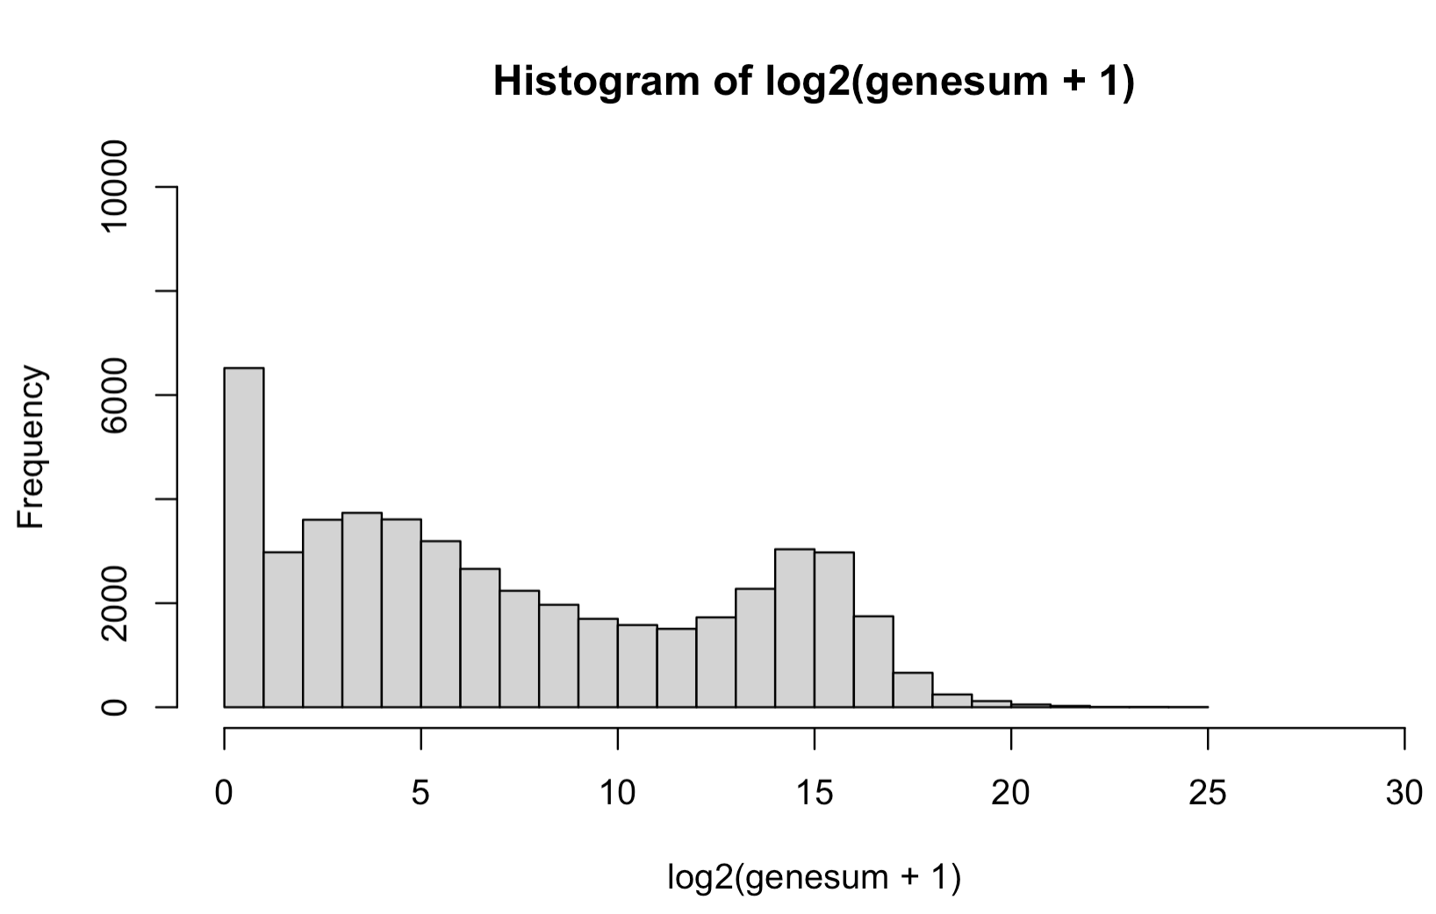
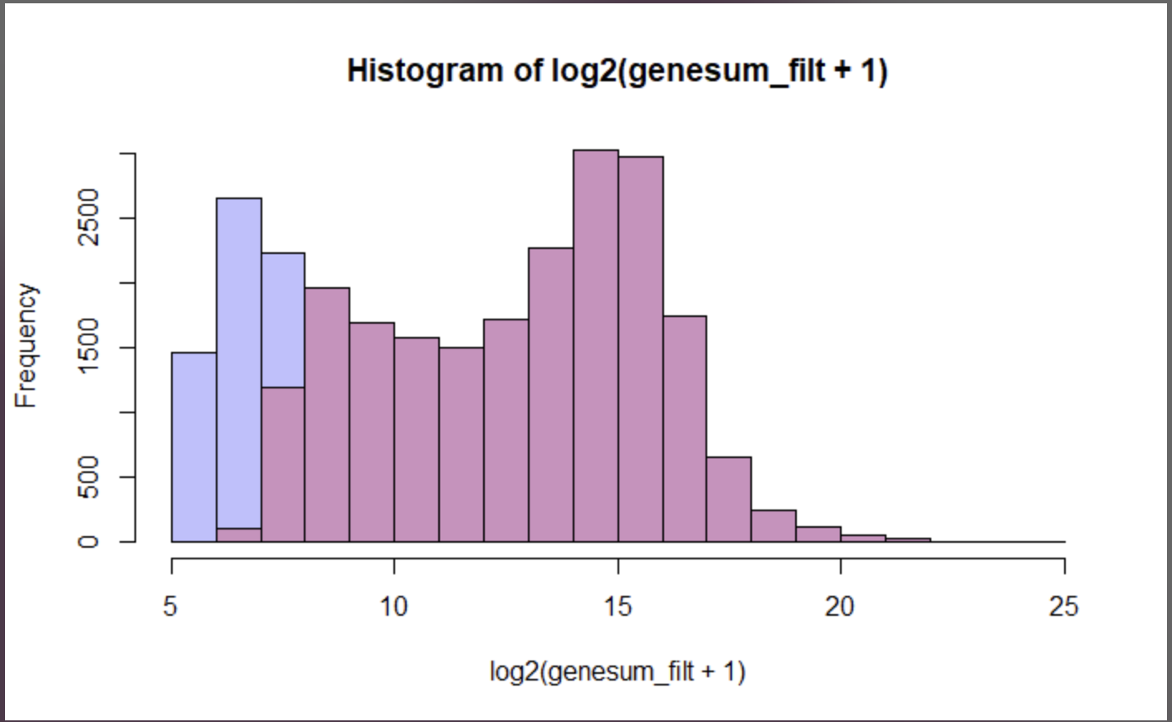
Pre-Processing
Violin Plot of unfiltered reads containing 48,162 genes. Note the heavy bottom of zero and near zero counts for many of the samples.
We tried a manual filtering with a rowsum across genes with a minimum count ~45,
genesum = 45 log2(45) = 5.52 = ~5.5, so we decided to cut all genes below 5, producing a dataset with 25,995 genes
Dataset was filtered utilizing Limma method for removing lowly expressed genes that resulted in a trimmed dataset of 20,935 gene candidates, from and original dataset of 48,162 genes.
25,995 Manual Filtered
48,162 unfiltered
20,935 Limma Filtered

Slide 5
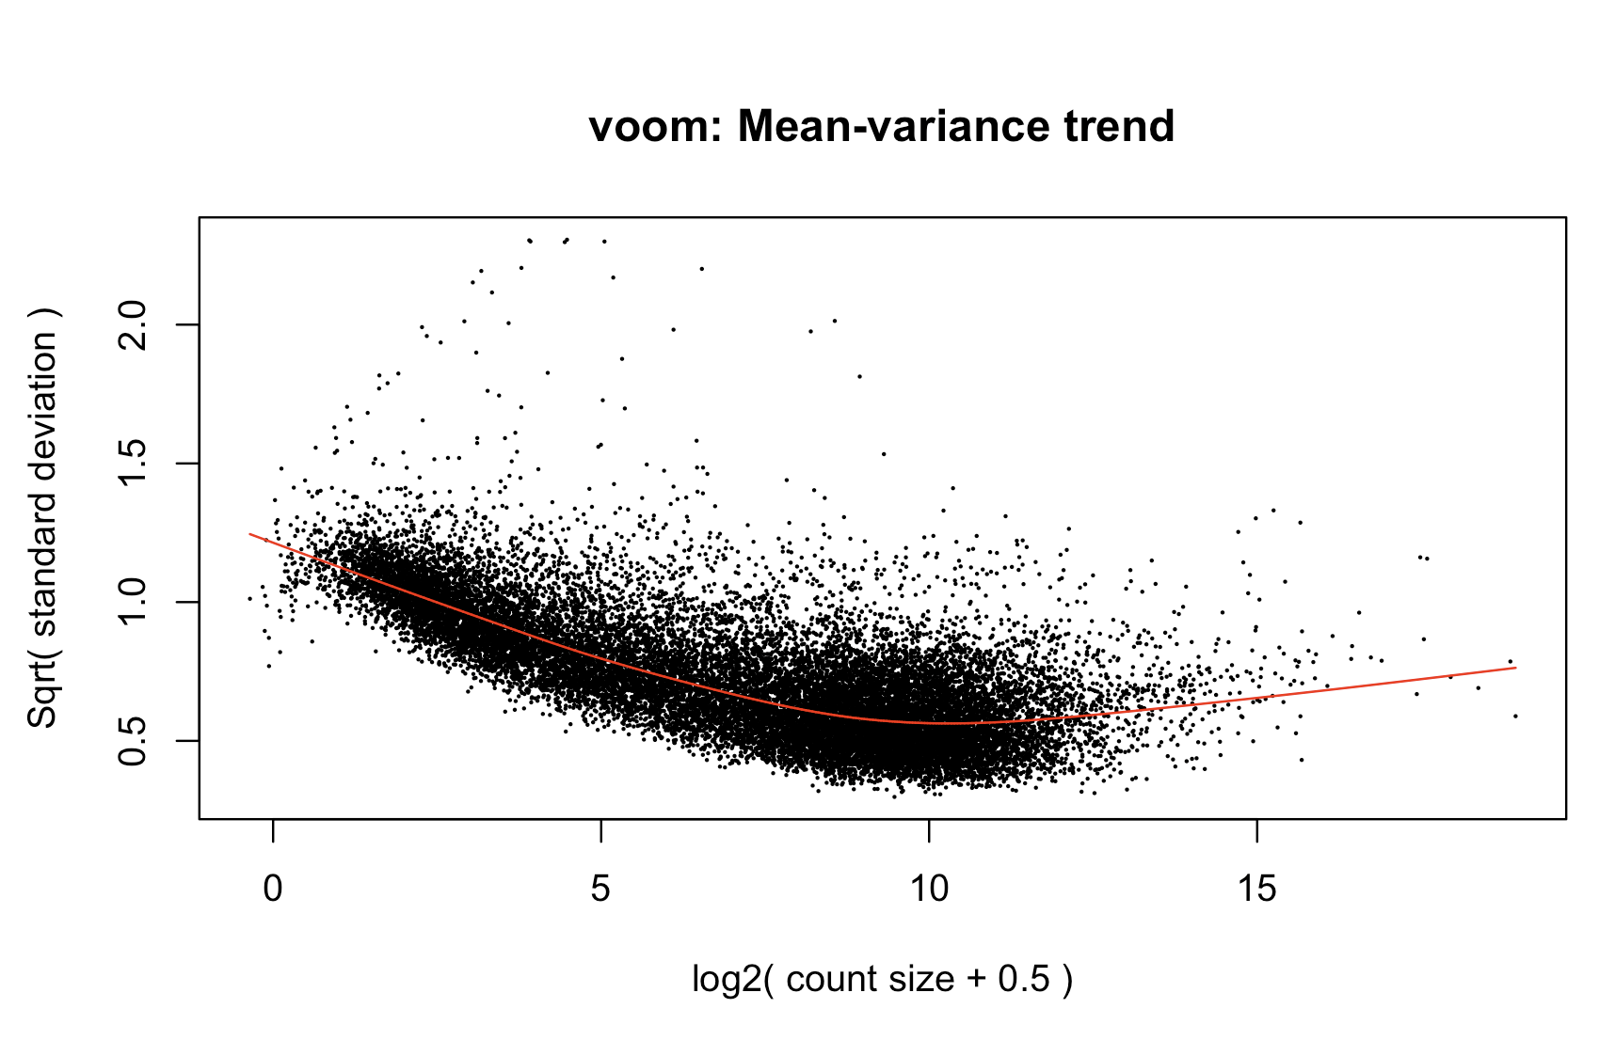
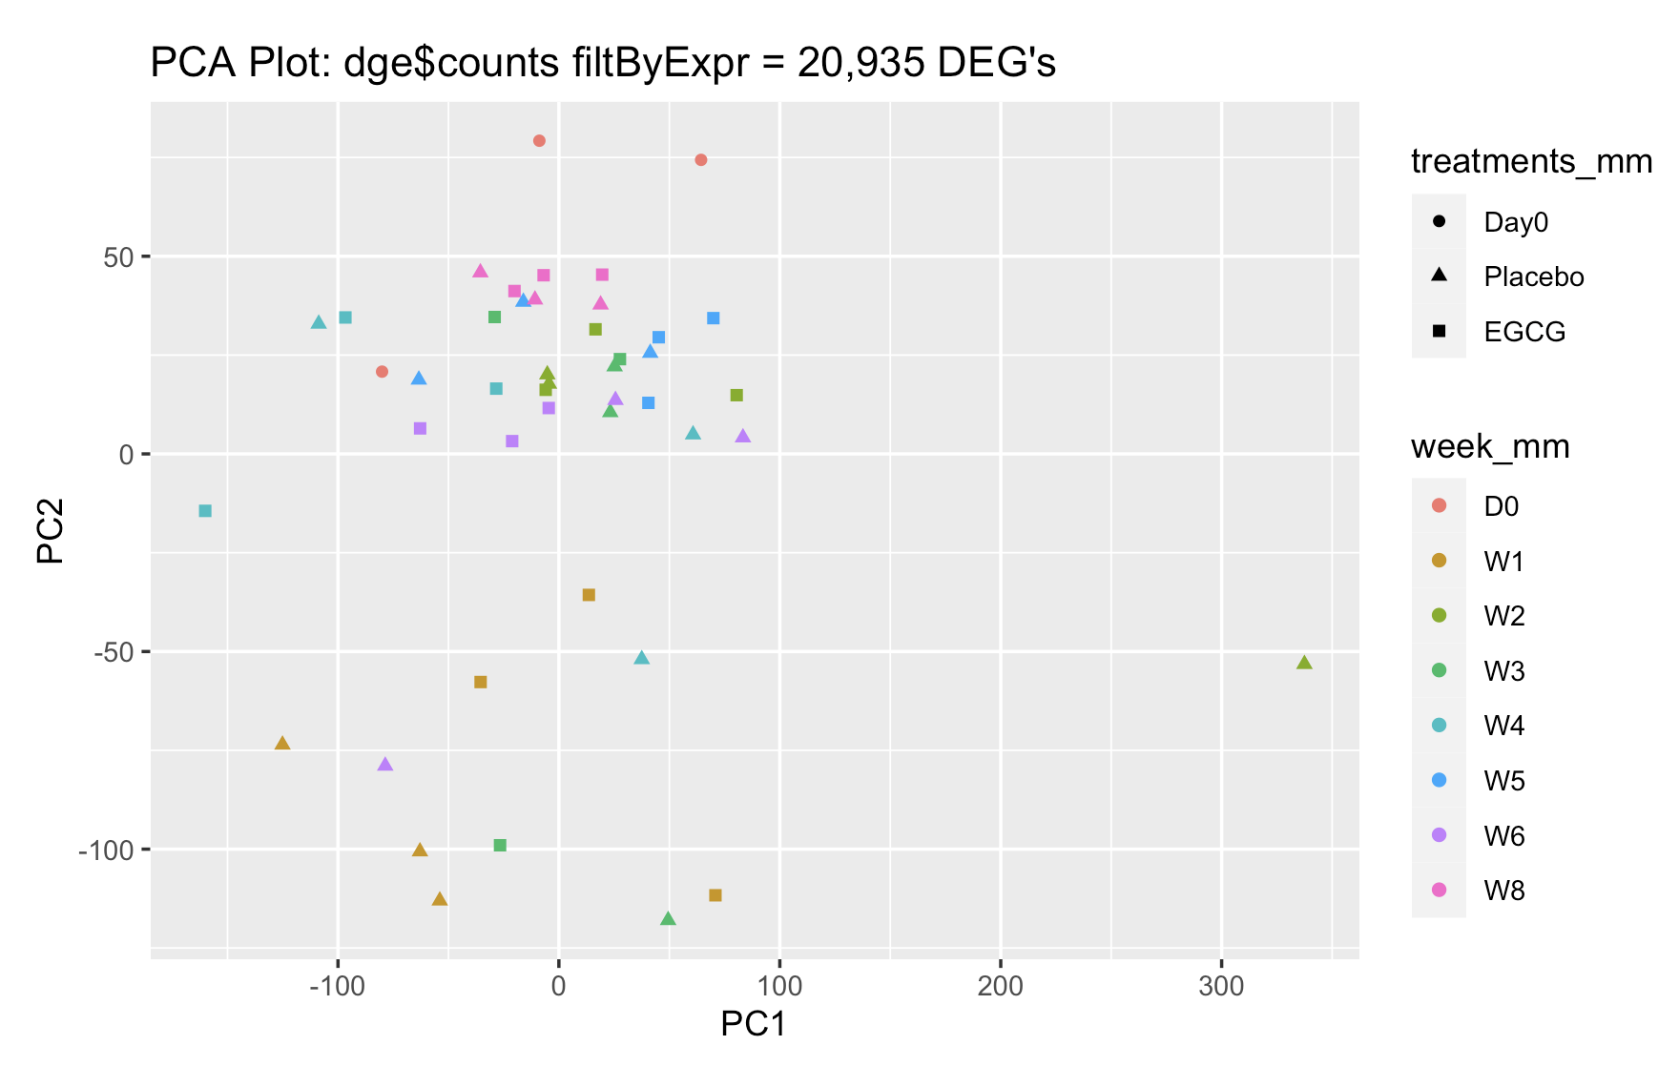
Pre-Processing
PCA analysis of Limma trimmed count data for the 20,935 genes we are progressing with for analysis.
Normalizing data with Voom method to allow for downstream analyses, such as selecting the top 10 differentially expressed genes, our comparison analyses, and clustering.

Slide 6
Results
Three Comparisons:
Week 1 EGCG vs Placebo
Week 1 vs Week 2: Relative to Treatment over time: EGCG Treatment
Week 1 vs Week 2: “Global Change” Week 1 vs Week 2

Slide 7
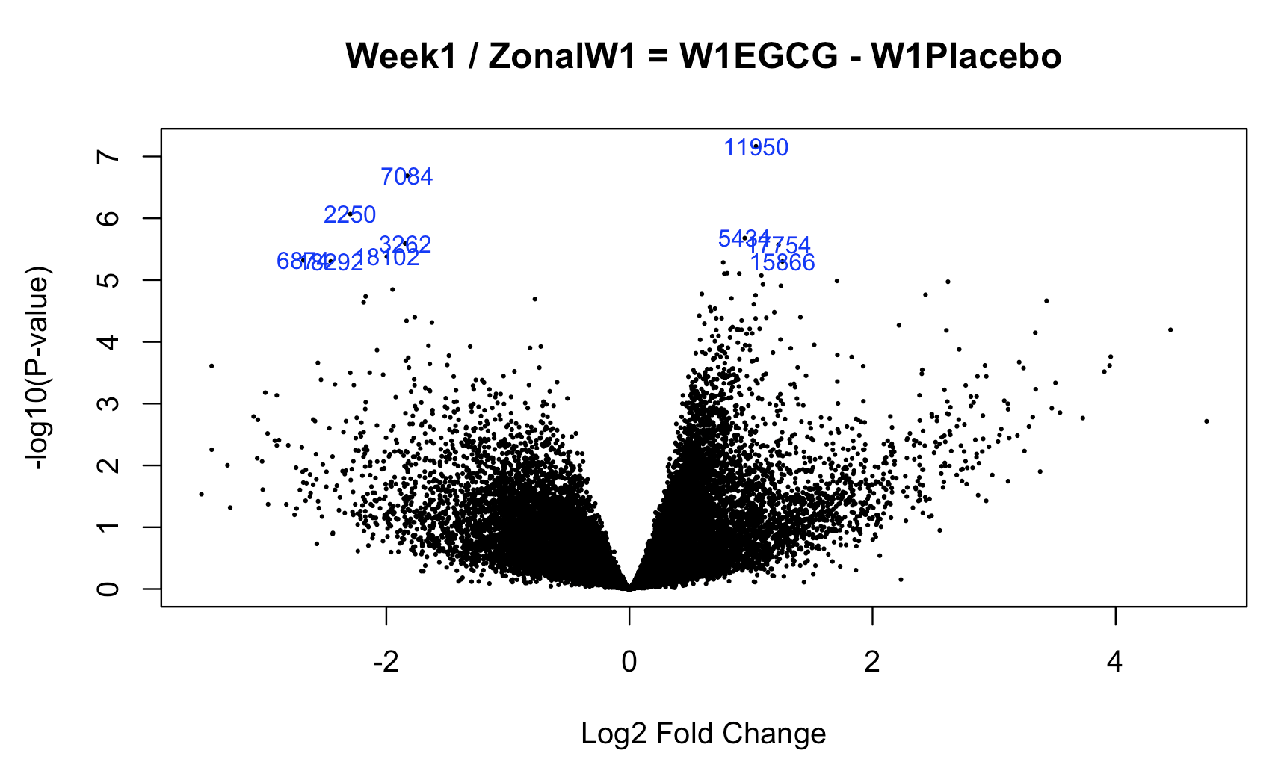
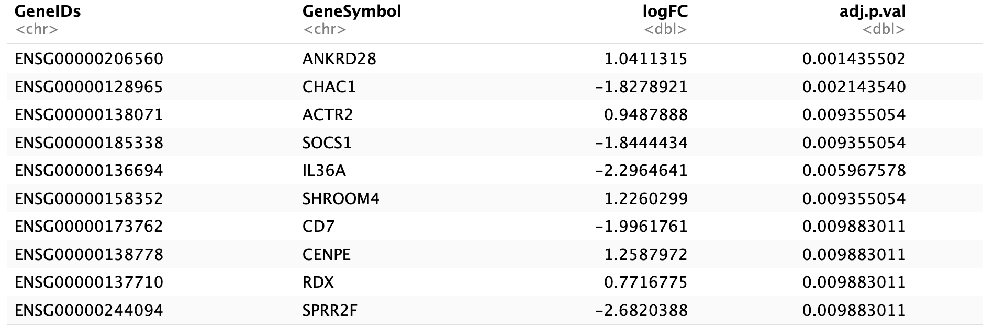
Results: Zonal Week 1 EGCG/CTRL
The only week that produced significant results was the “Zonal Week 1 EGCG/CTRL”
Below is the Top 10 significantly Differentially Expressed Genes (DEGs) from LIMMA analysis, indicated in the blue reference rownames in the associated Volcano Plot
Top 10 genes are involved in:
Immunity, Inflammation, Cytokines, Cytoskeleton, Shape and Motility, Cell division. IL36A was similarly identified in the paper as being significantly down-regulated.

Slide 8
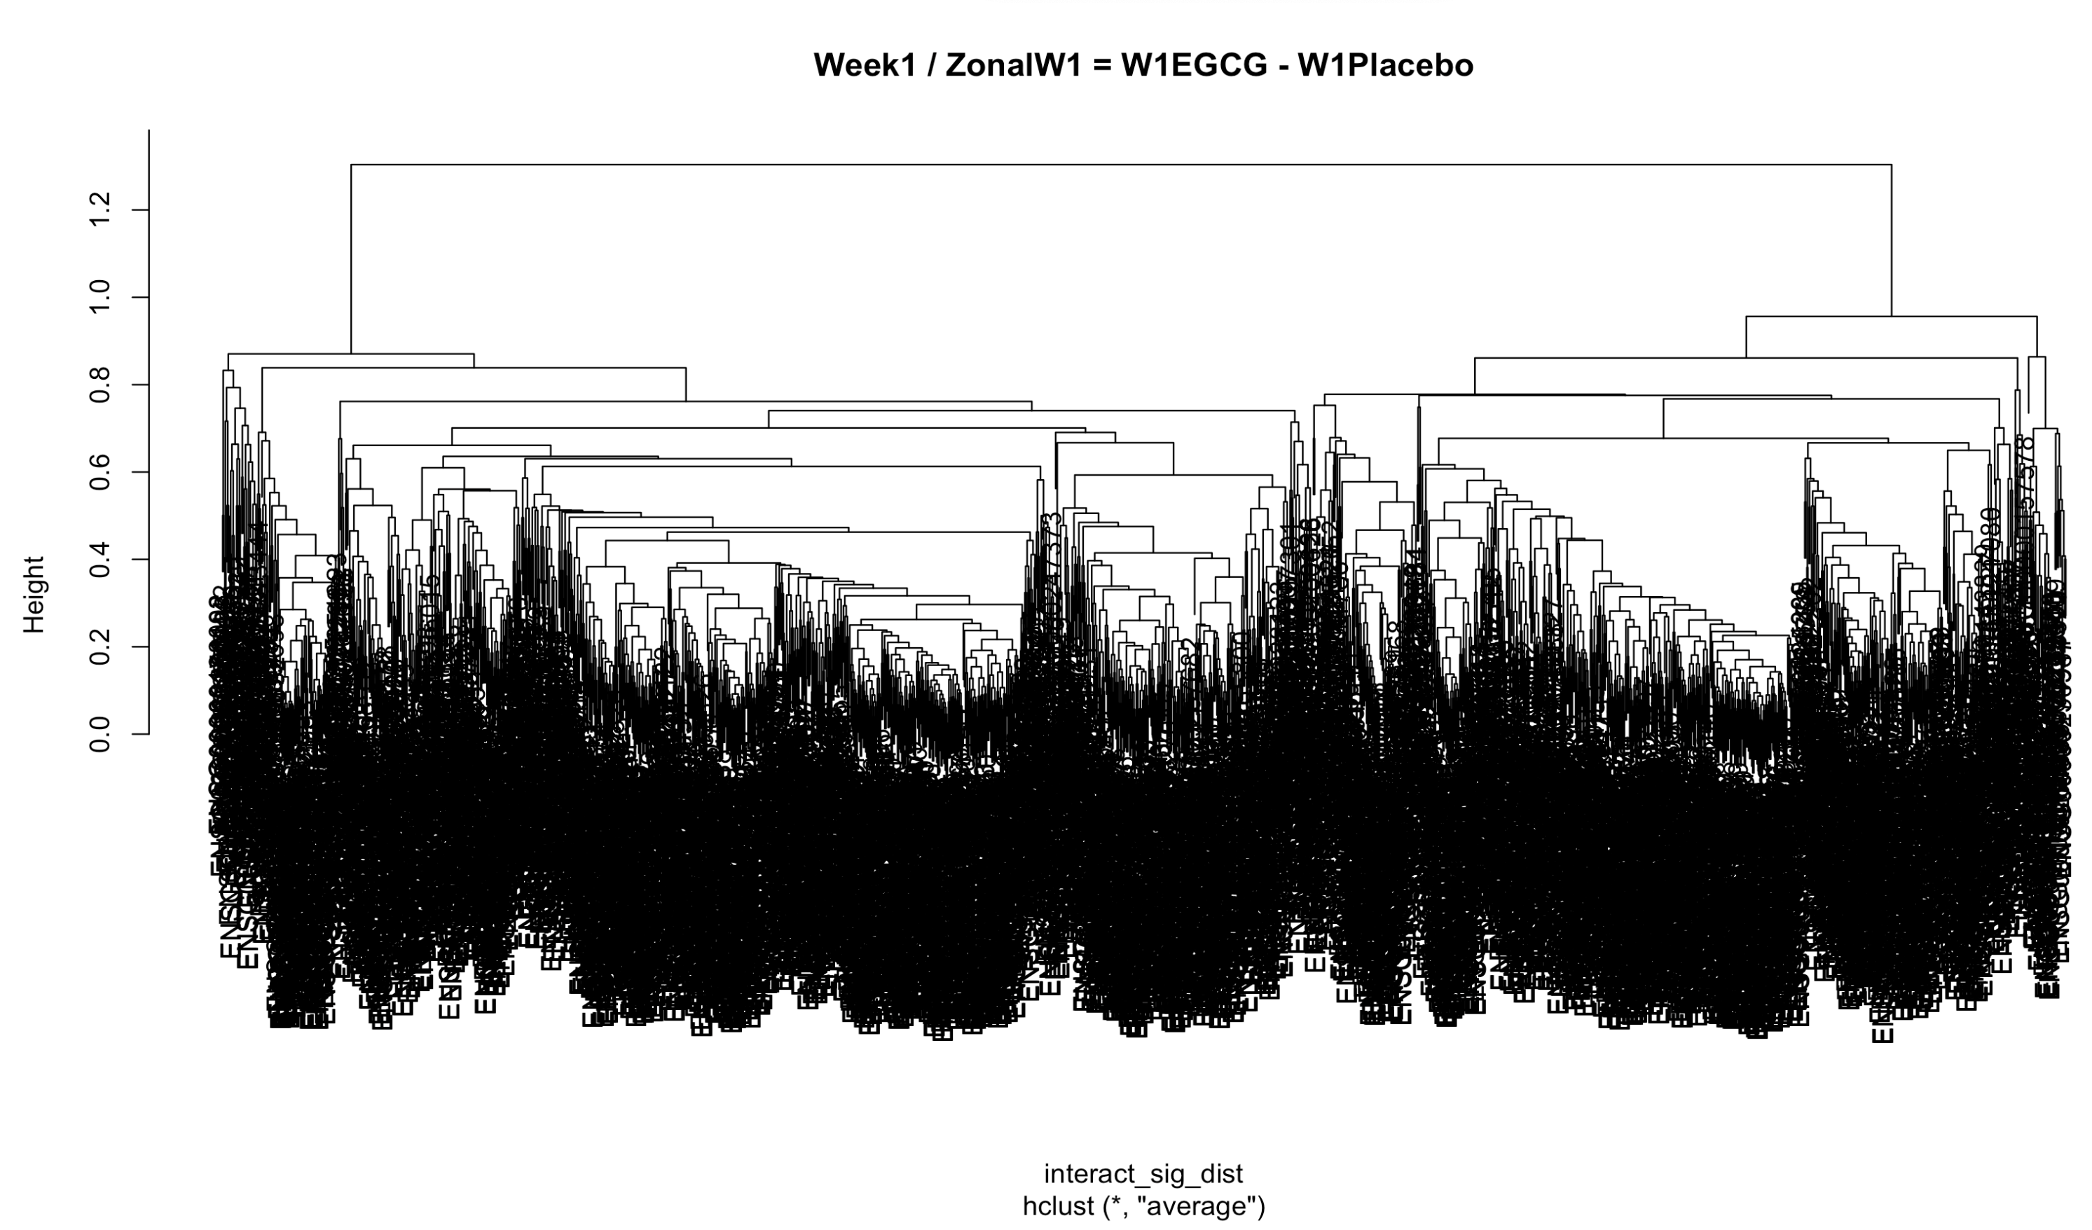
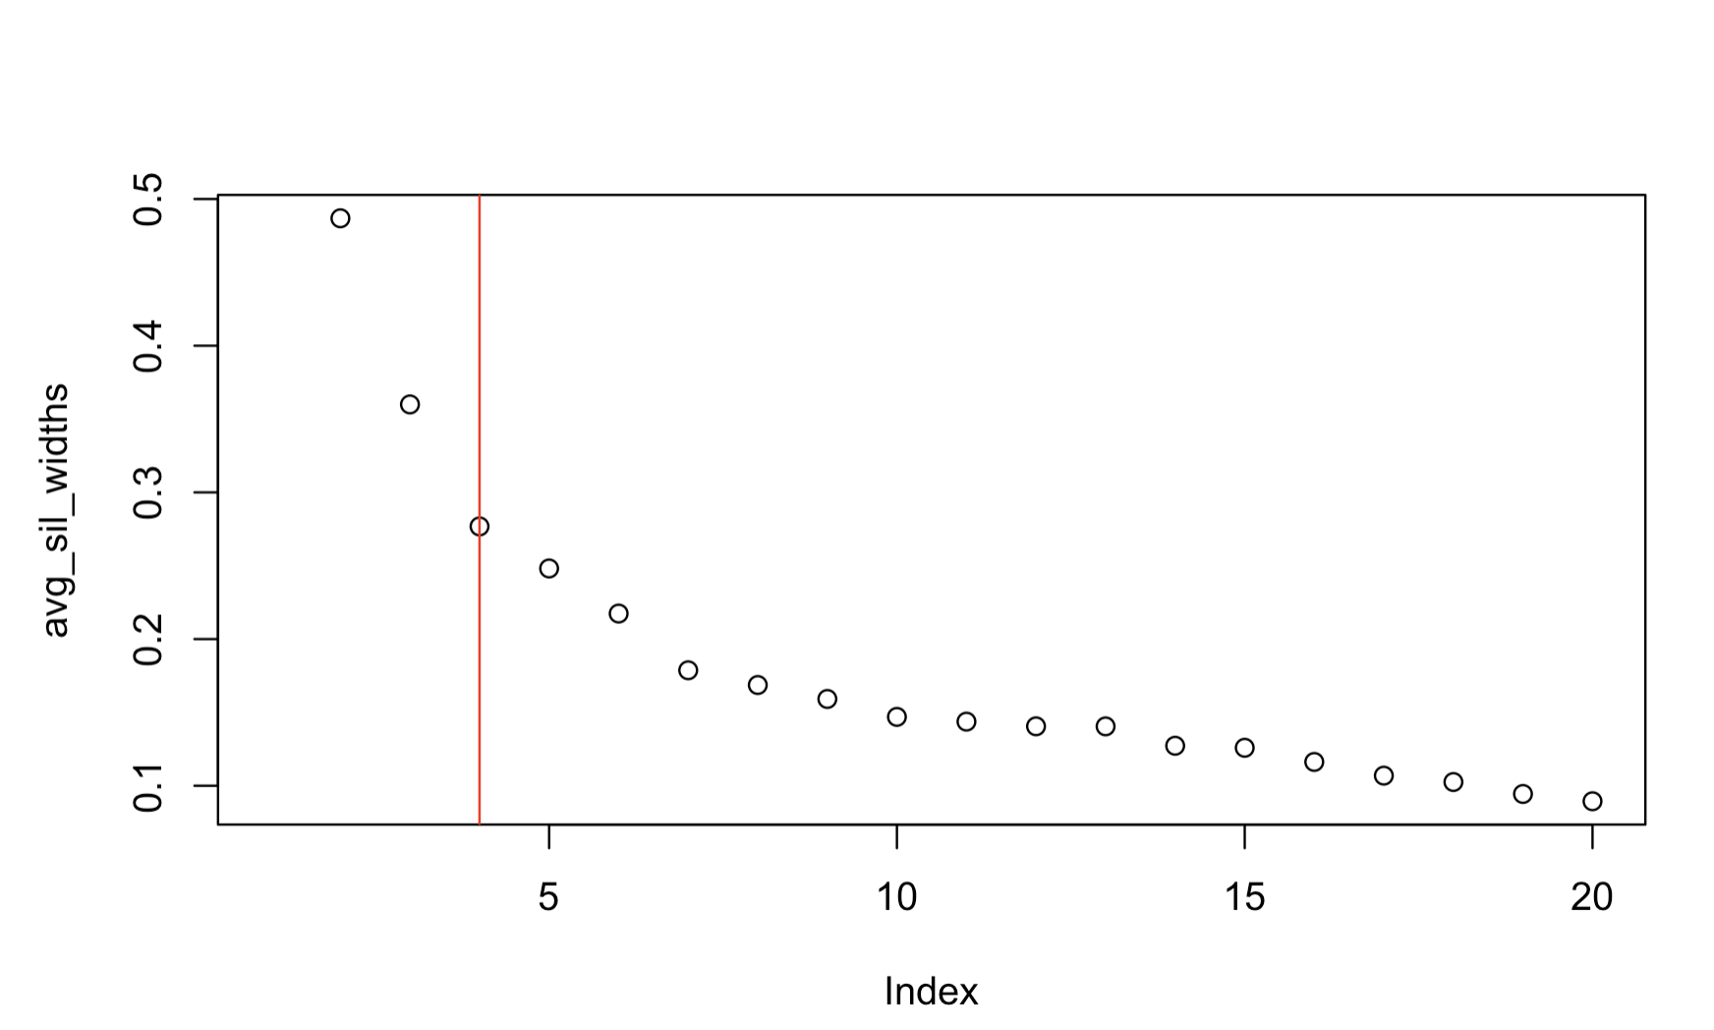
Results: Zonal Week 1 EGCG/CTRL
To keep p-value cutoffs for DEG analysis the same between all comparisons, we had to implement a FDR cutoff of 0.2 and a L2FC of 1.5 in order to capture enough significant gene candidates for cluster analysis.
This produced a hierarchical clustering graph for Zonal Week 1 that was congested, so a Silhouette plot was utilized to determine ideal clustering selection, which was determined k=4.
K was based on the silhouette width that may not have been the largest distance, but it was the largest distance before the decreased slope and observed plateau, we selected the “bend” at the “elbow” of te plot..

Slide 9
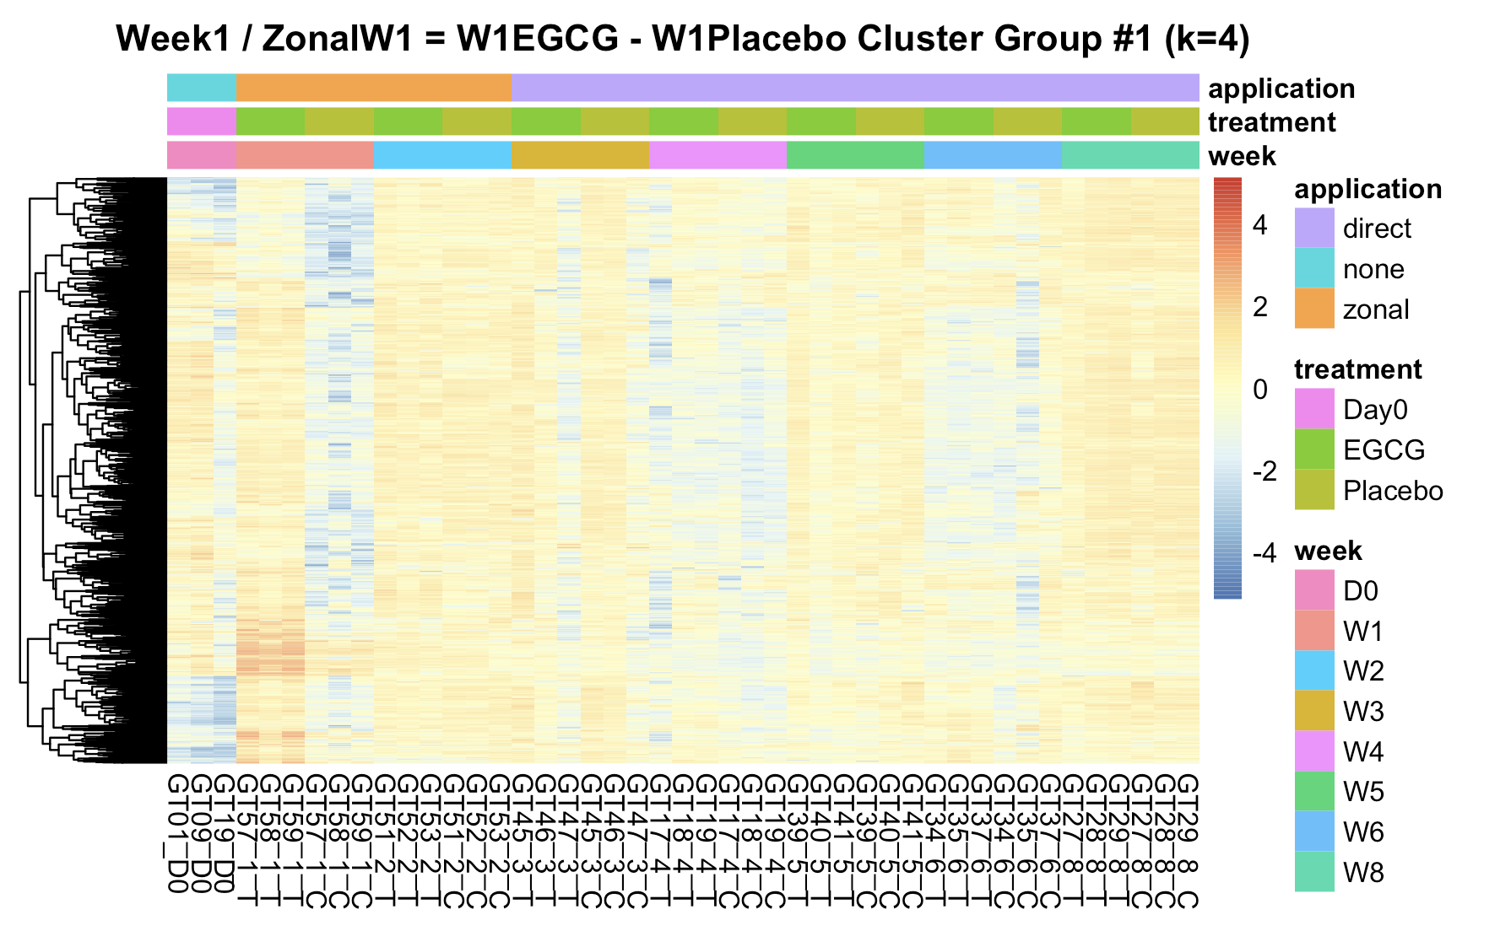
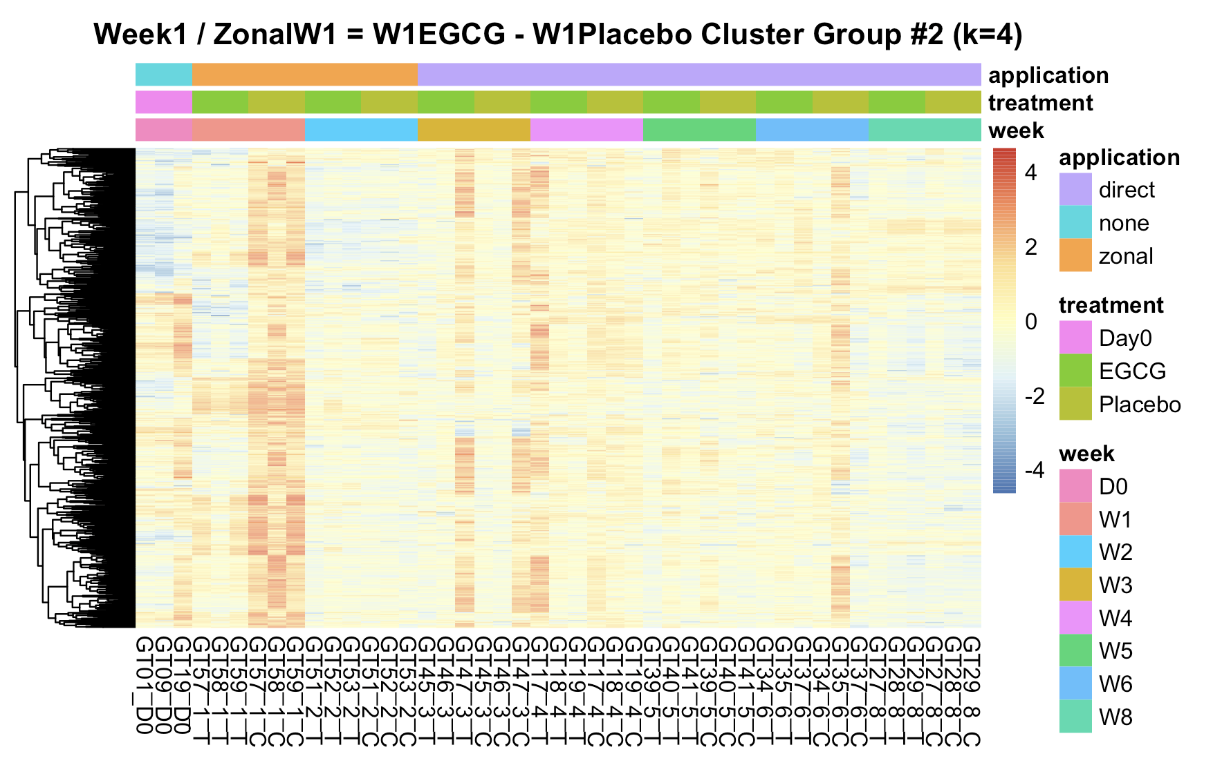
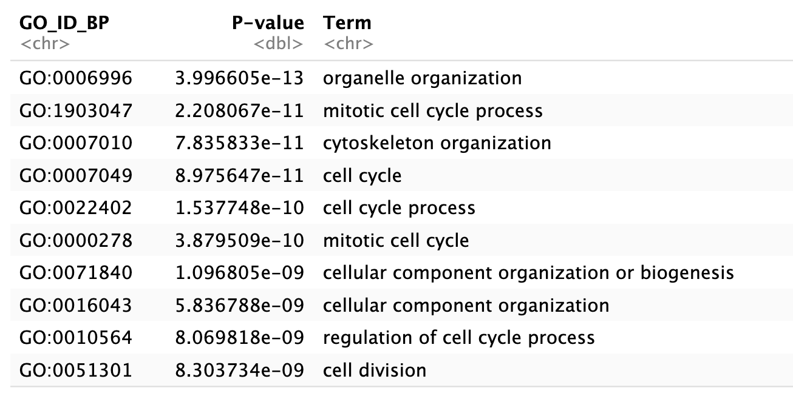
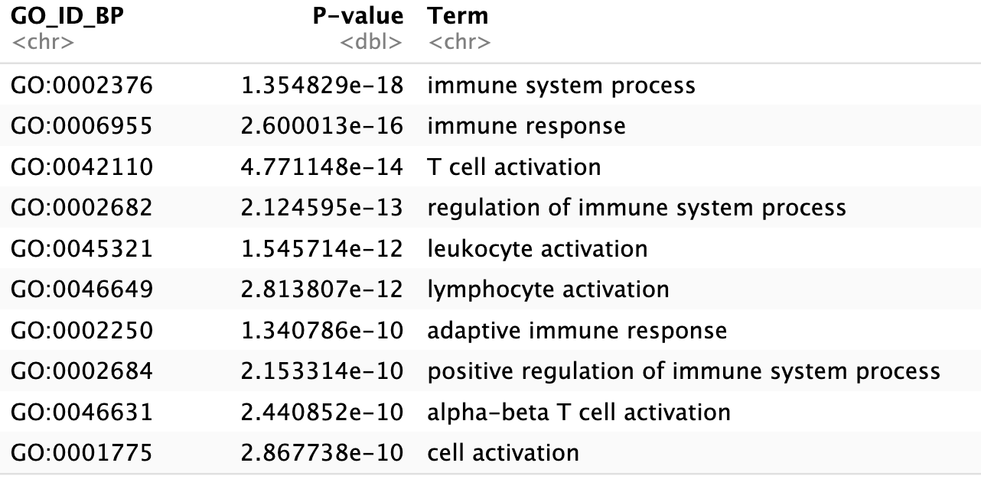
Results: Zonal Week 1 EGCG/CTRL
Heatmaps were generated for each cluster, with associated Go-Term Enrichment analysis for each cluster. These are for Clusters 1 + 2
Cytoskeleton / Cell Cycle/ Cellular Organization
Immune System Processes

Slide 10
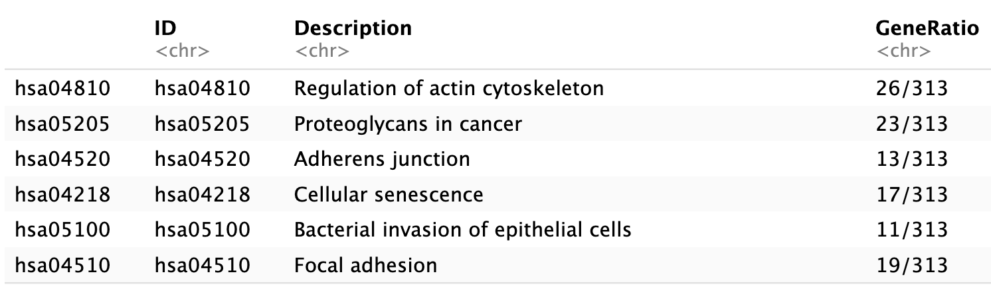
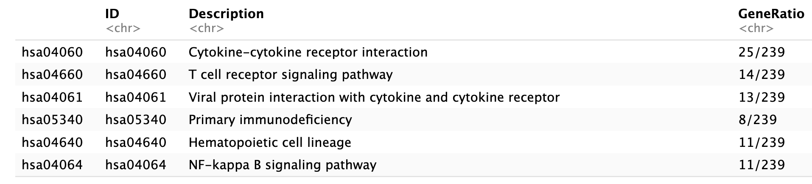
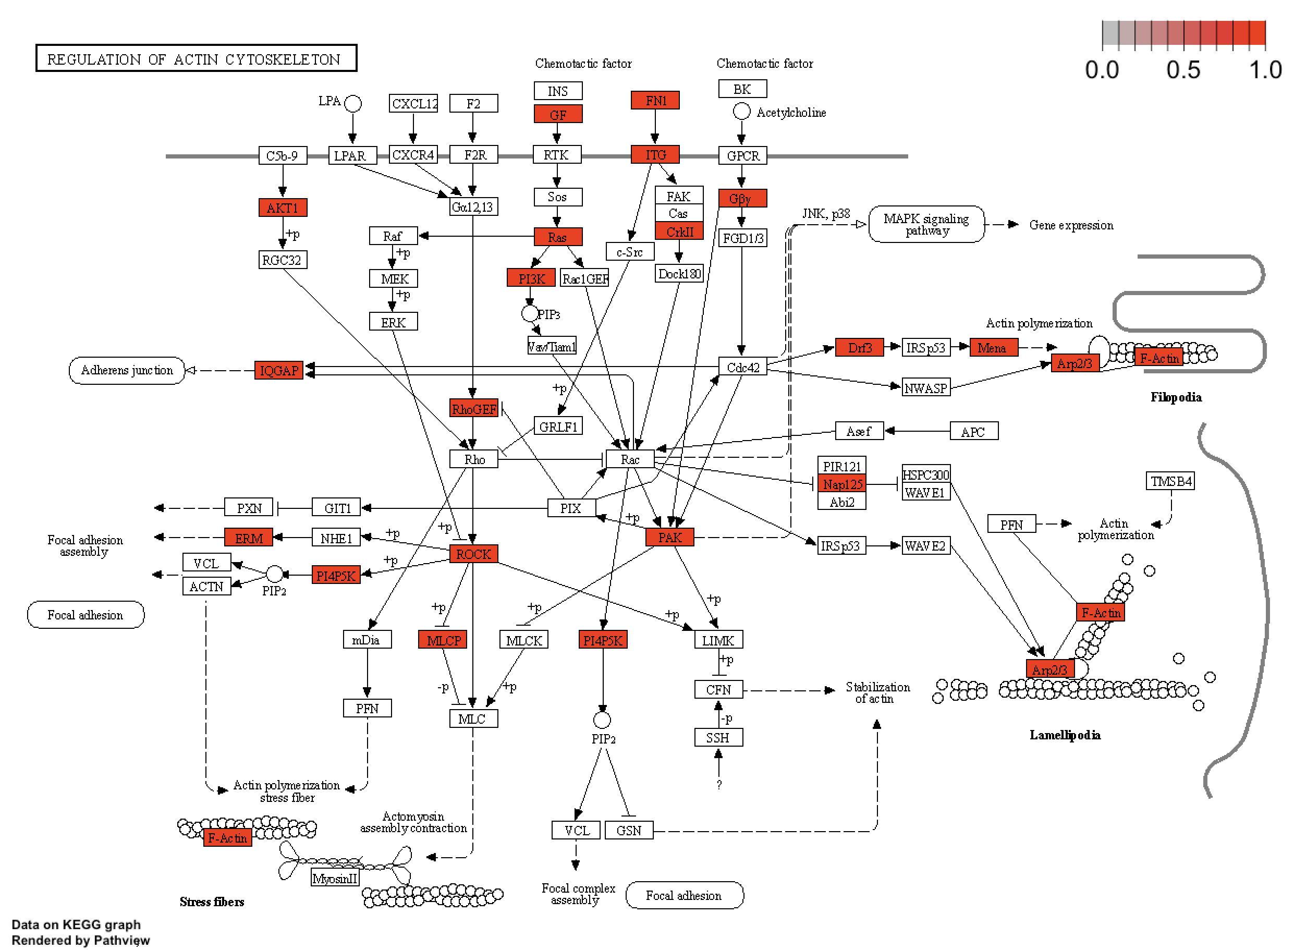
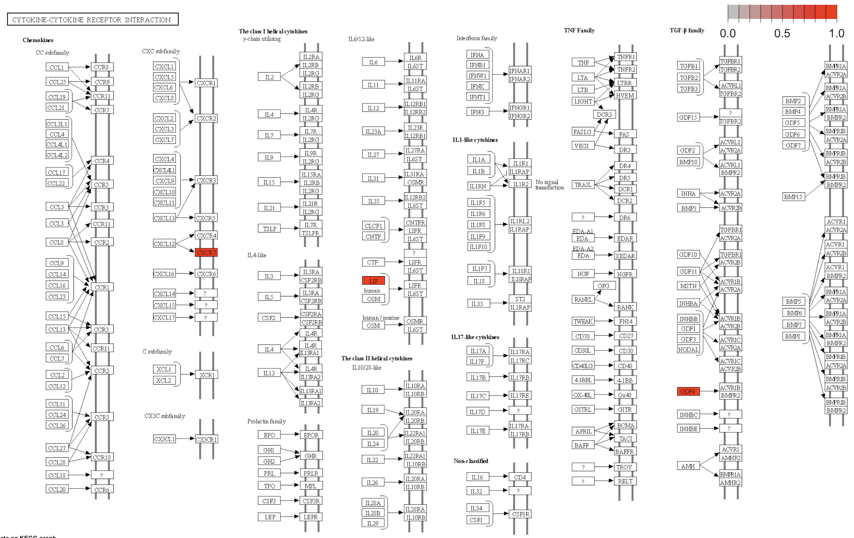
Results: Zonal Week 1 EGCG/CTRL
Cluster Group 1
Cluster Group 2

Slide 11
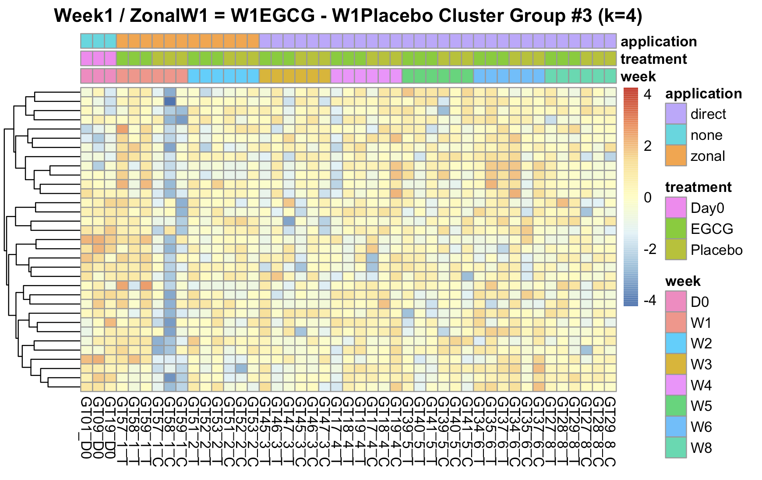
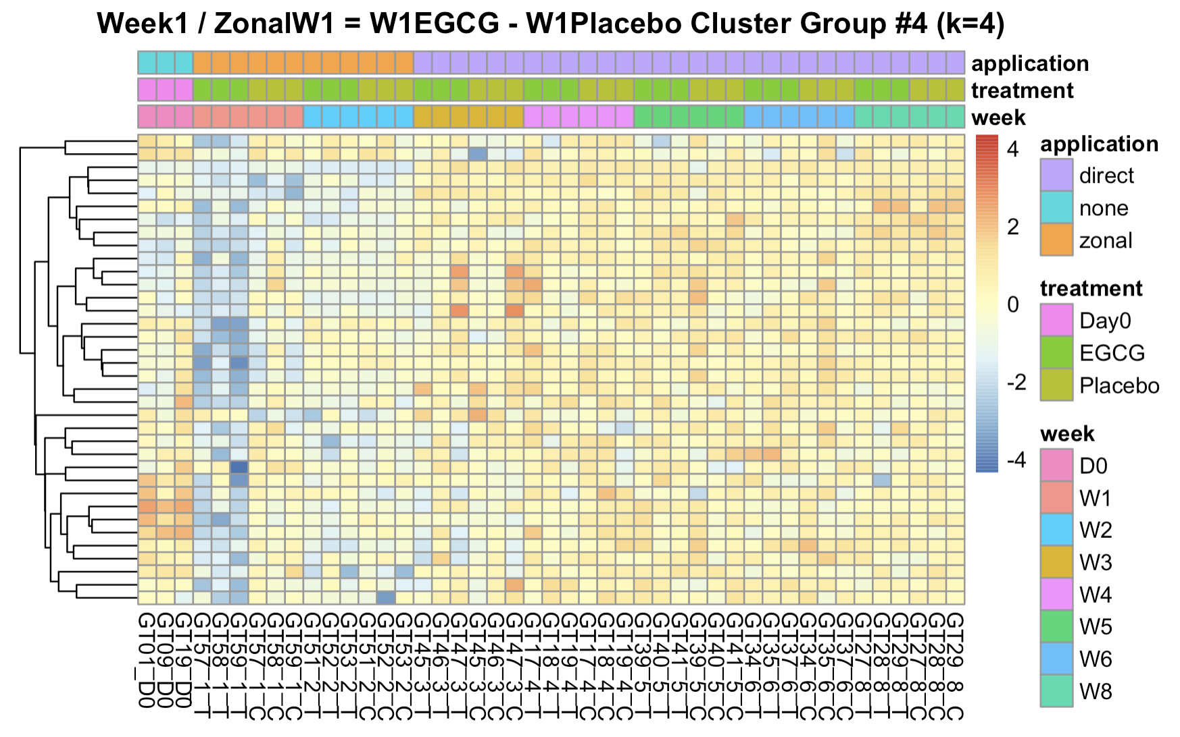
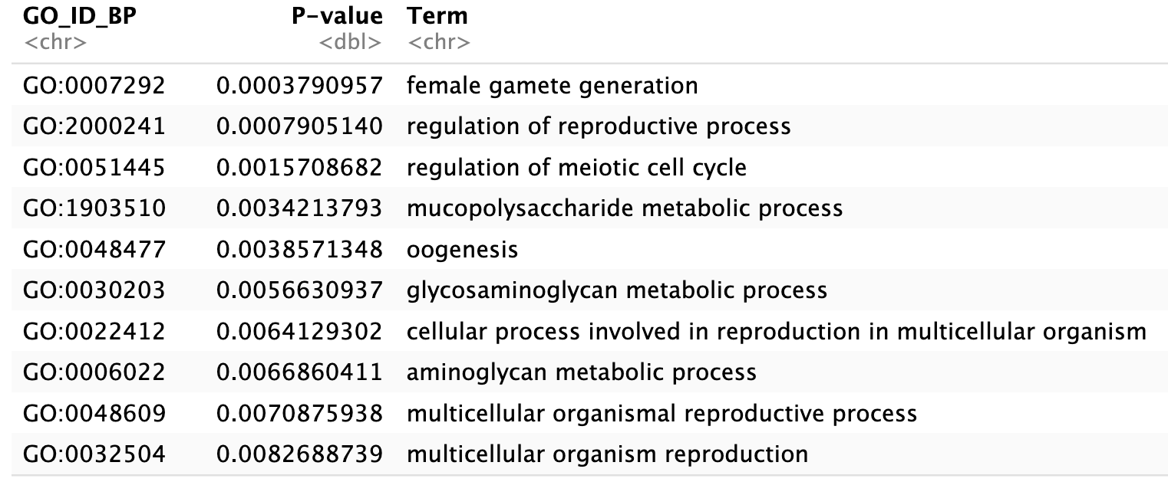
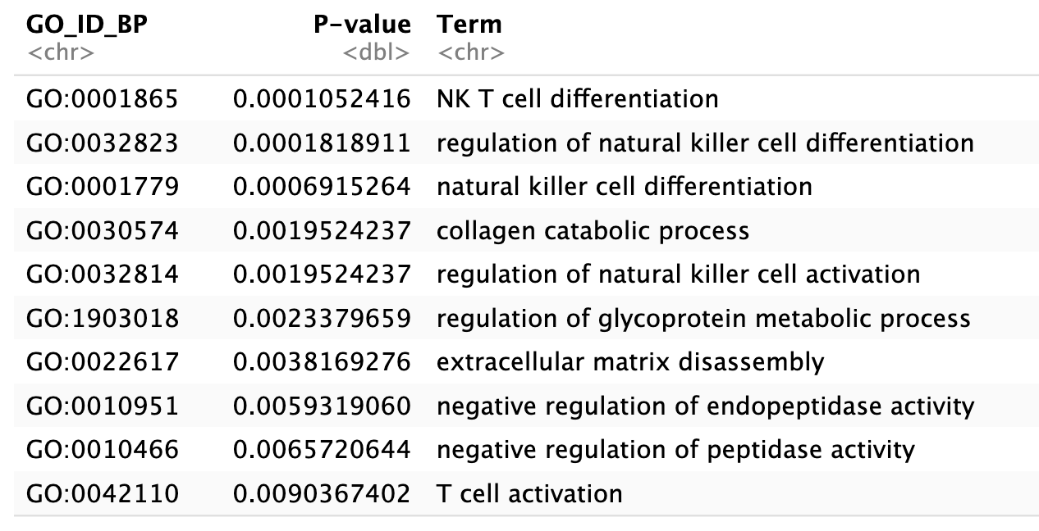
Results: Zonal Week 1 EGCG/CTRL
Heatmaps were generated for each cluster, with associated Go-Term Enrichment analysis for each cluster. These are for Clusters 3 + 4
Metabolic Processes / Reproduction?
Immune / ECM / Protein pepsidases

Slide 12
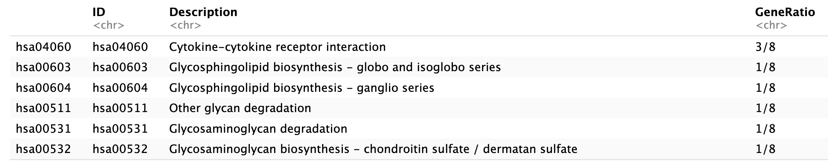
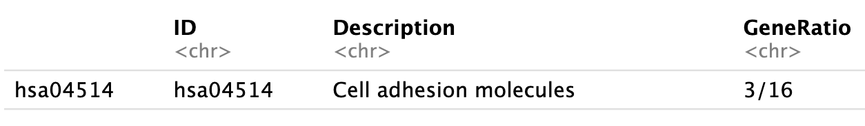
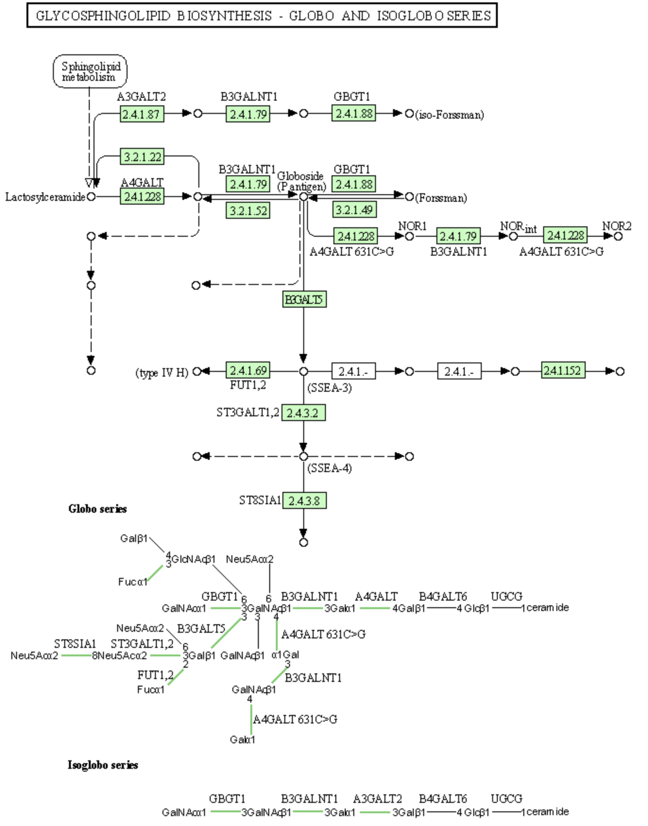
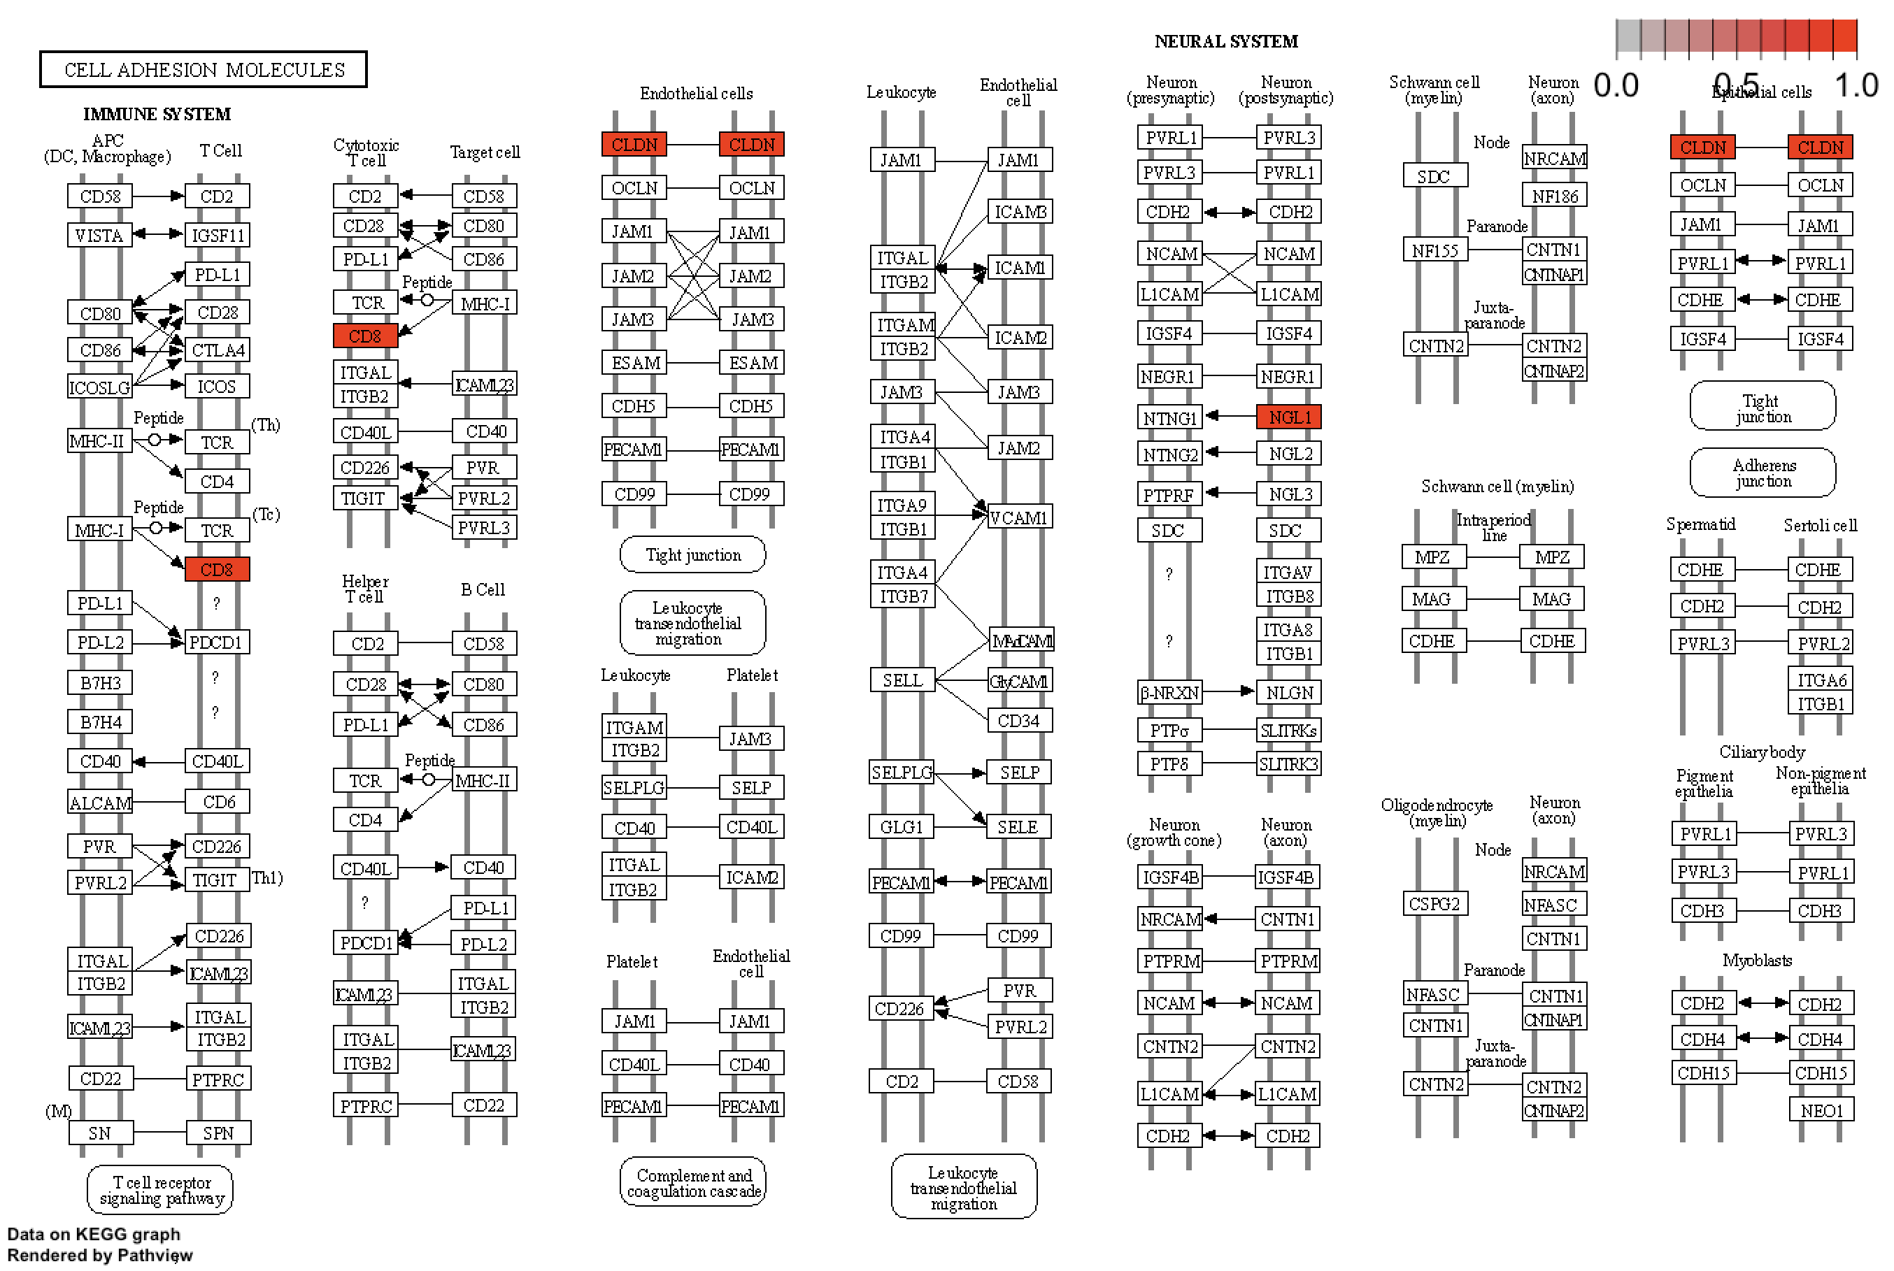
Results: Zonal Week 1 EGCG/CTRL
Cluster Group 3
Cluster Group 4

Slide 13
Results
Three Comparisons:
Week 1 EGCG vs Placebo
Week 1 vs Week 2: Explore Treatment effects over time:
Week 1 vs Week 2: “Global Change” Week 1 vs Week 2

Slide 14
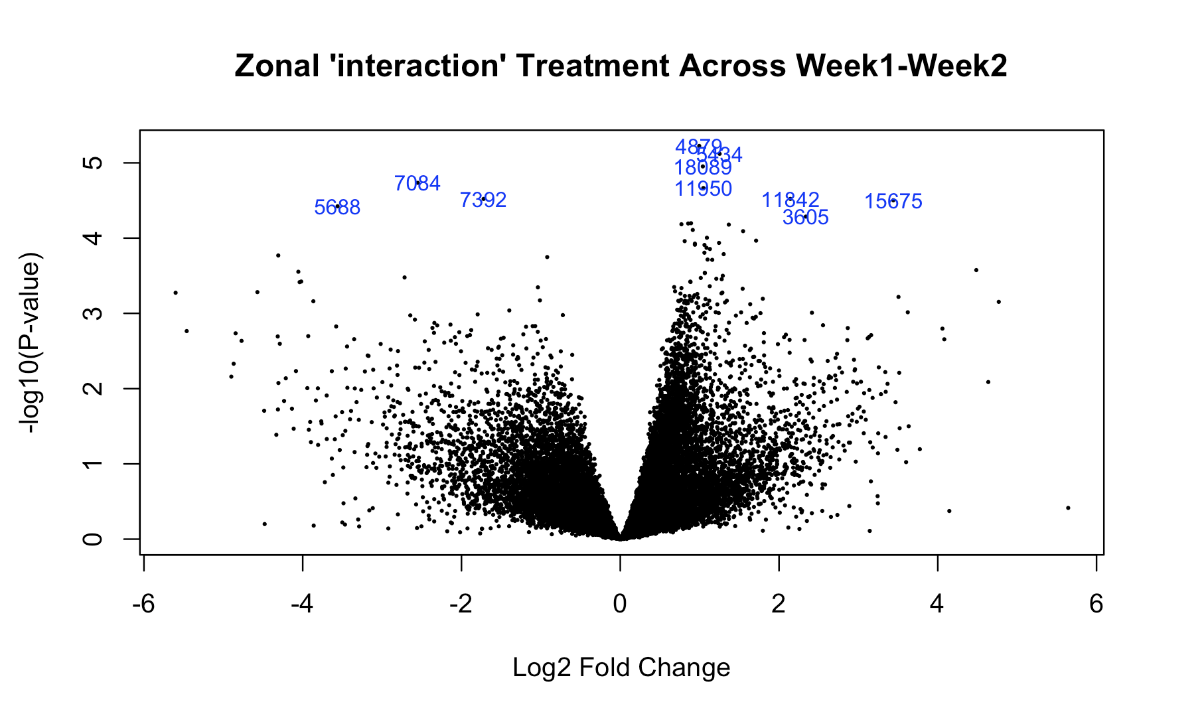
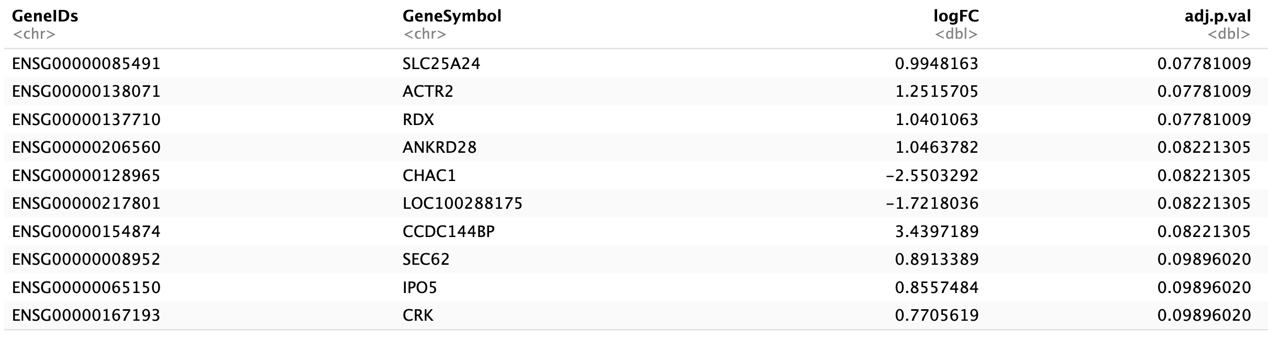
Results: Zonal Week 1 vs Week 2
Below is the Top 10 significantly Differentially Expressed Genes (DEGs) from LIMMA analysis, indicated in the blue reference rownames in the associated Volcano Plot.
Which we were able to convert into table format for identification
Highlighted top 10 genes are common to Week1 EGCG vs Placebo
Additional genes related to: Energy, Wound Healing, ECM Remodeling, Protein Translocation.

Slide 15
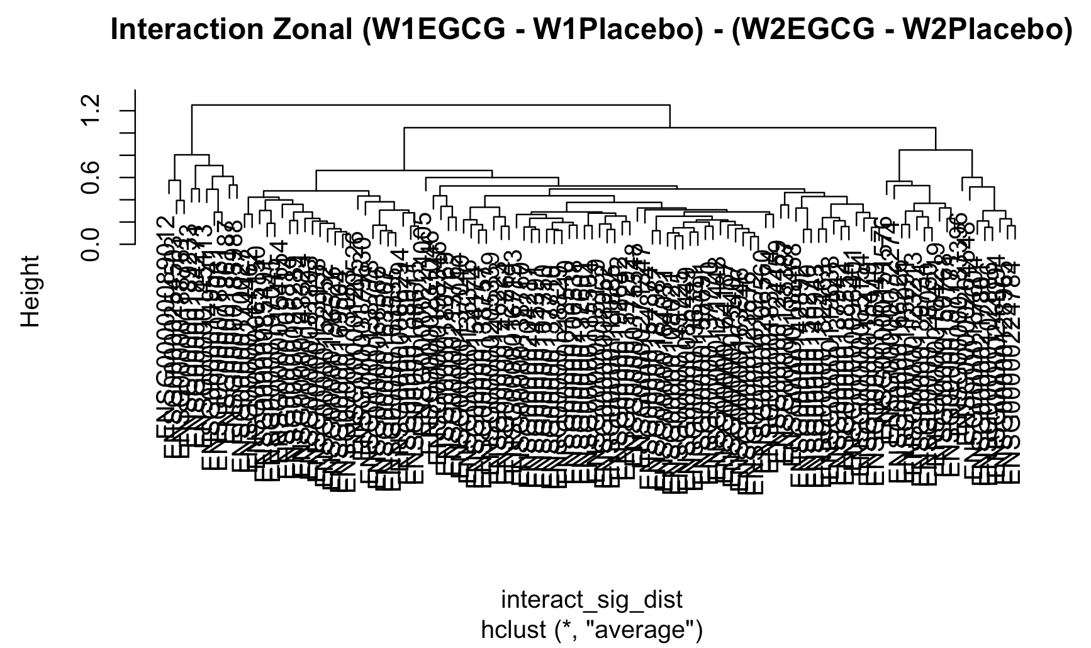
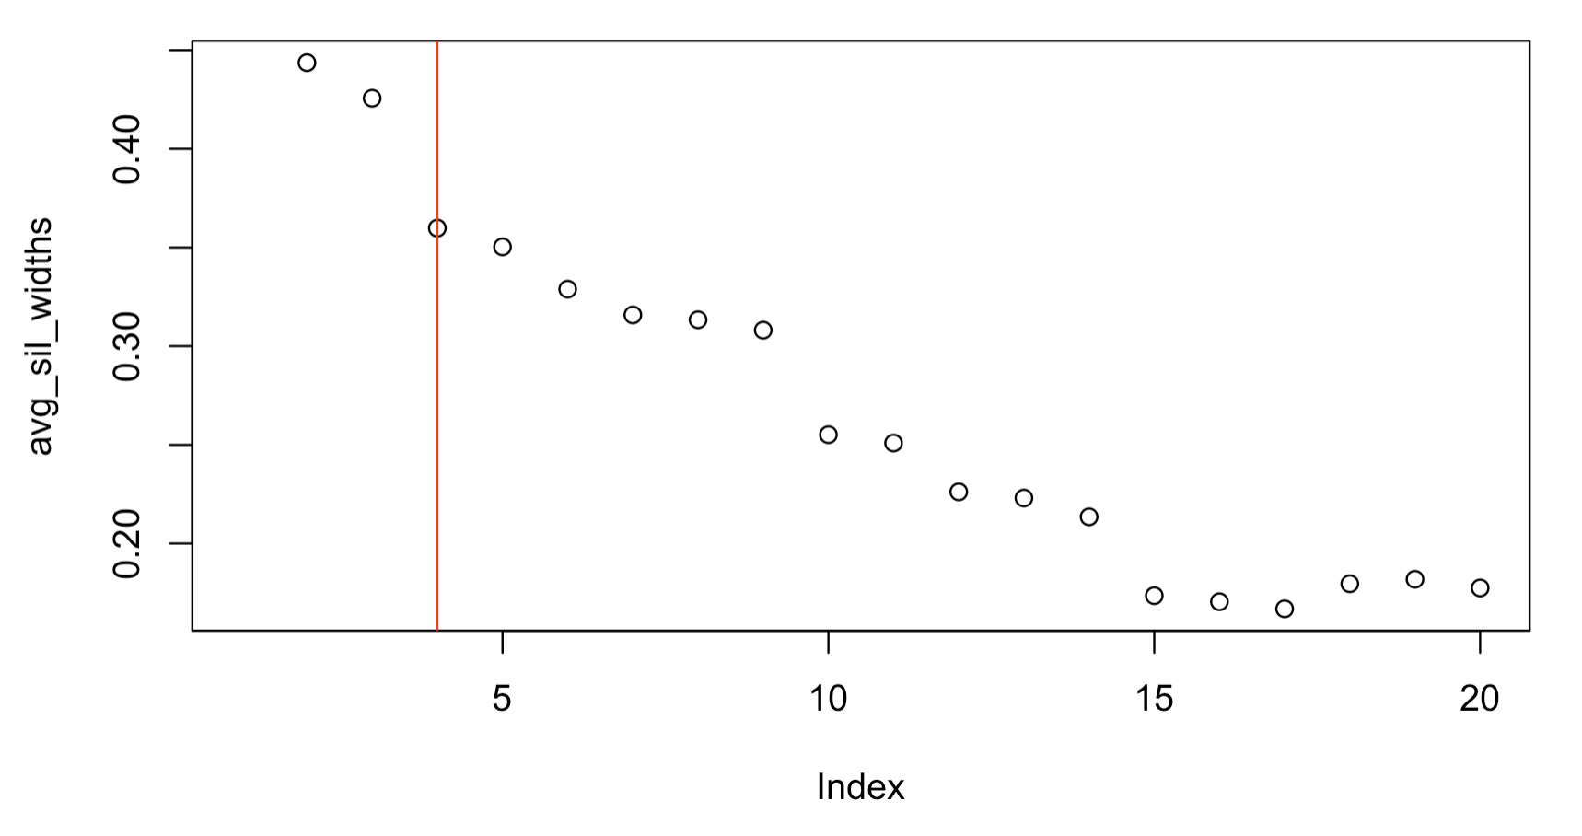
Results: Zonal Week 1 vs Week 2
To keep p-value cutoffs for DEG analysis the same between all comparisons, we had to implement a FDR cutoff of 0.2 and a L2FC of 1.5 in order to capture enough significant gene candidates for cluster analysis.
This produced a hierarchical clustering graph for Zonal Week 1 vs Week 2 that was less congested than previous, however the aid of a Silhouette plot was utilized to determine ideal clustering selection, which was determined k=4.
K was based on the sharp decline for this cluster, which created a break-point that we felt was fit for analysis. Other interesting clusters were at 10 and 15.

Slide 16
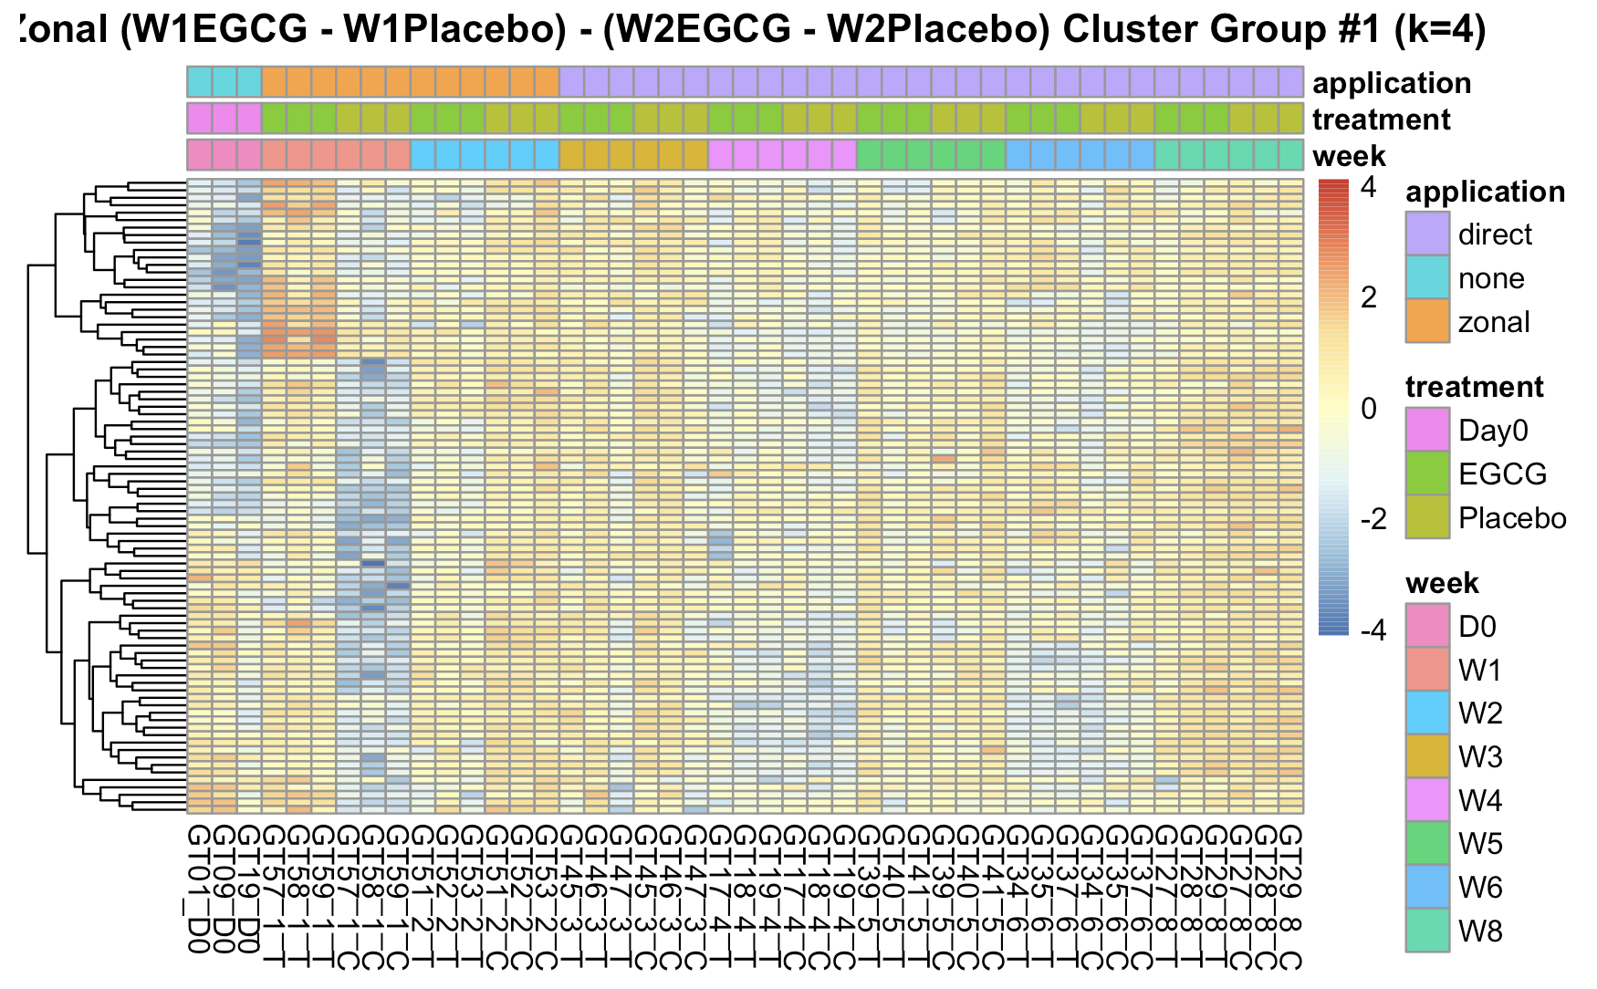
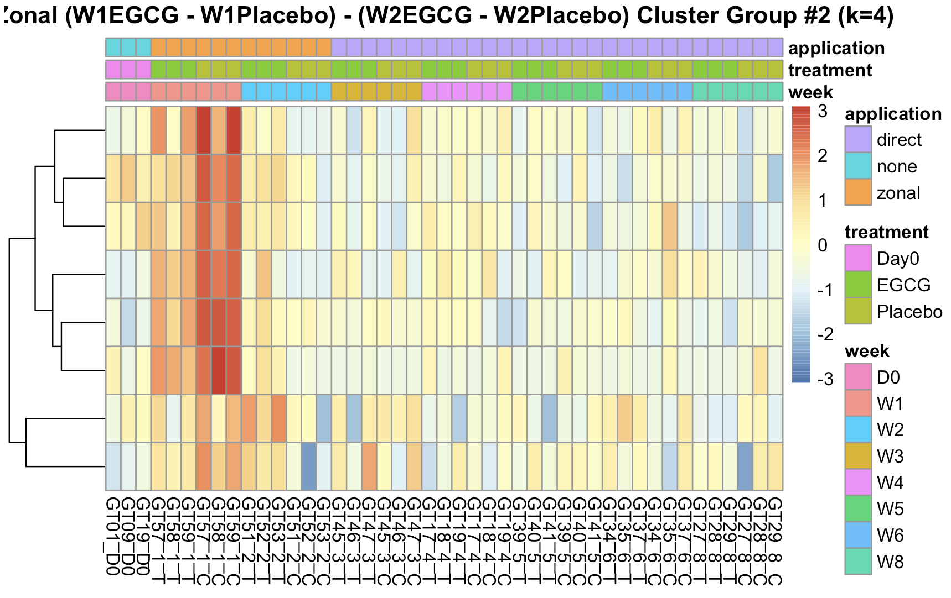
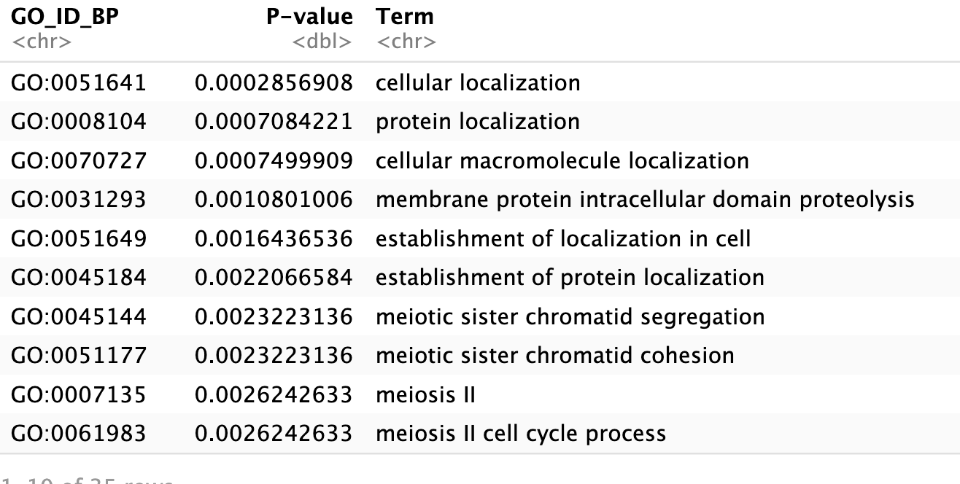
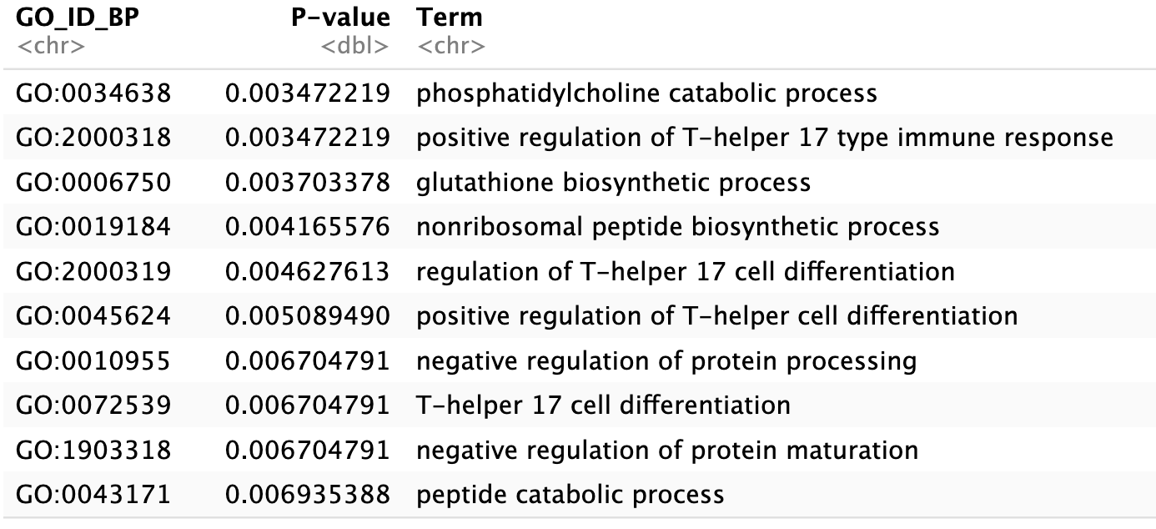
Results: Zonal Week 1 vs Week 2
Heatmaps were generated for each cluster, with associated Go-Term Enrichment analysis for each cluster. These are for Clusters 1 + 2
Localization
Immune and protein production regulation

Slide 17
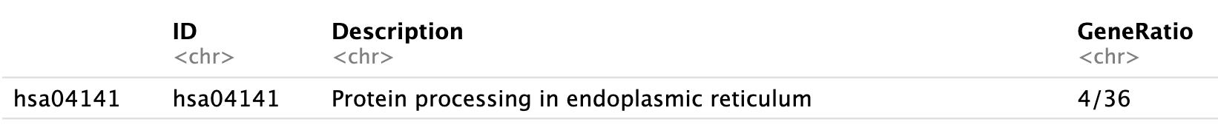
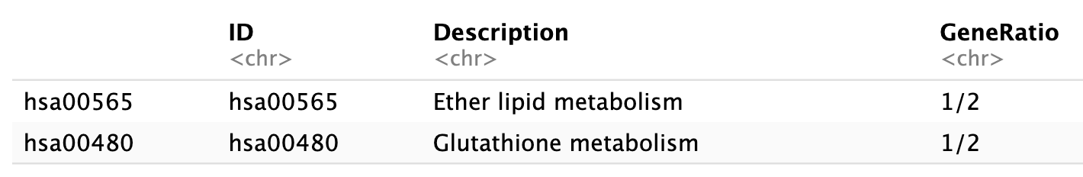
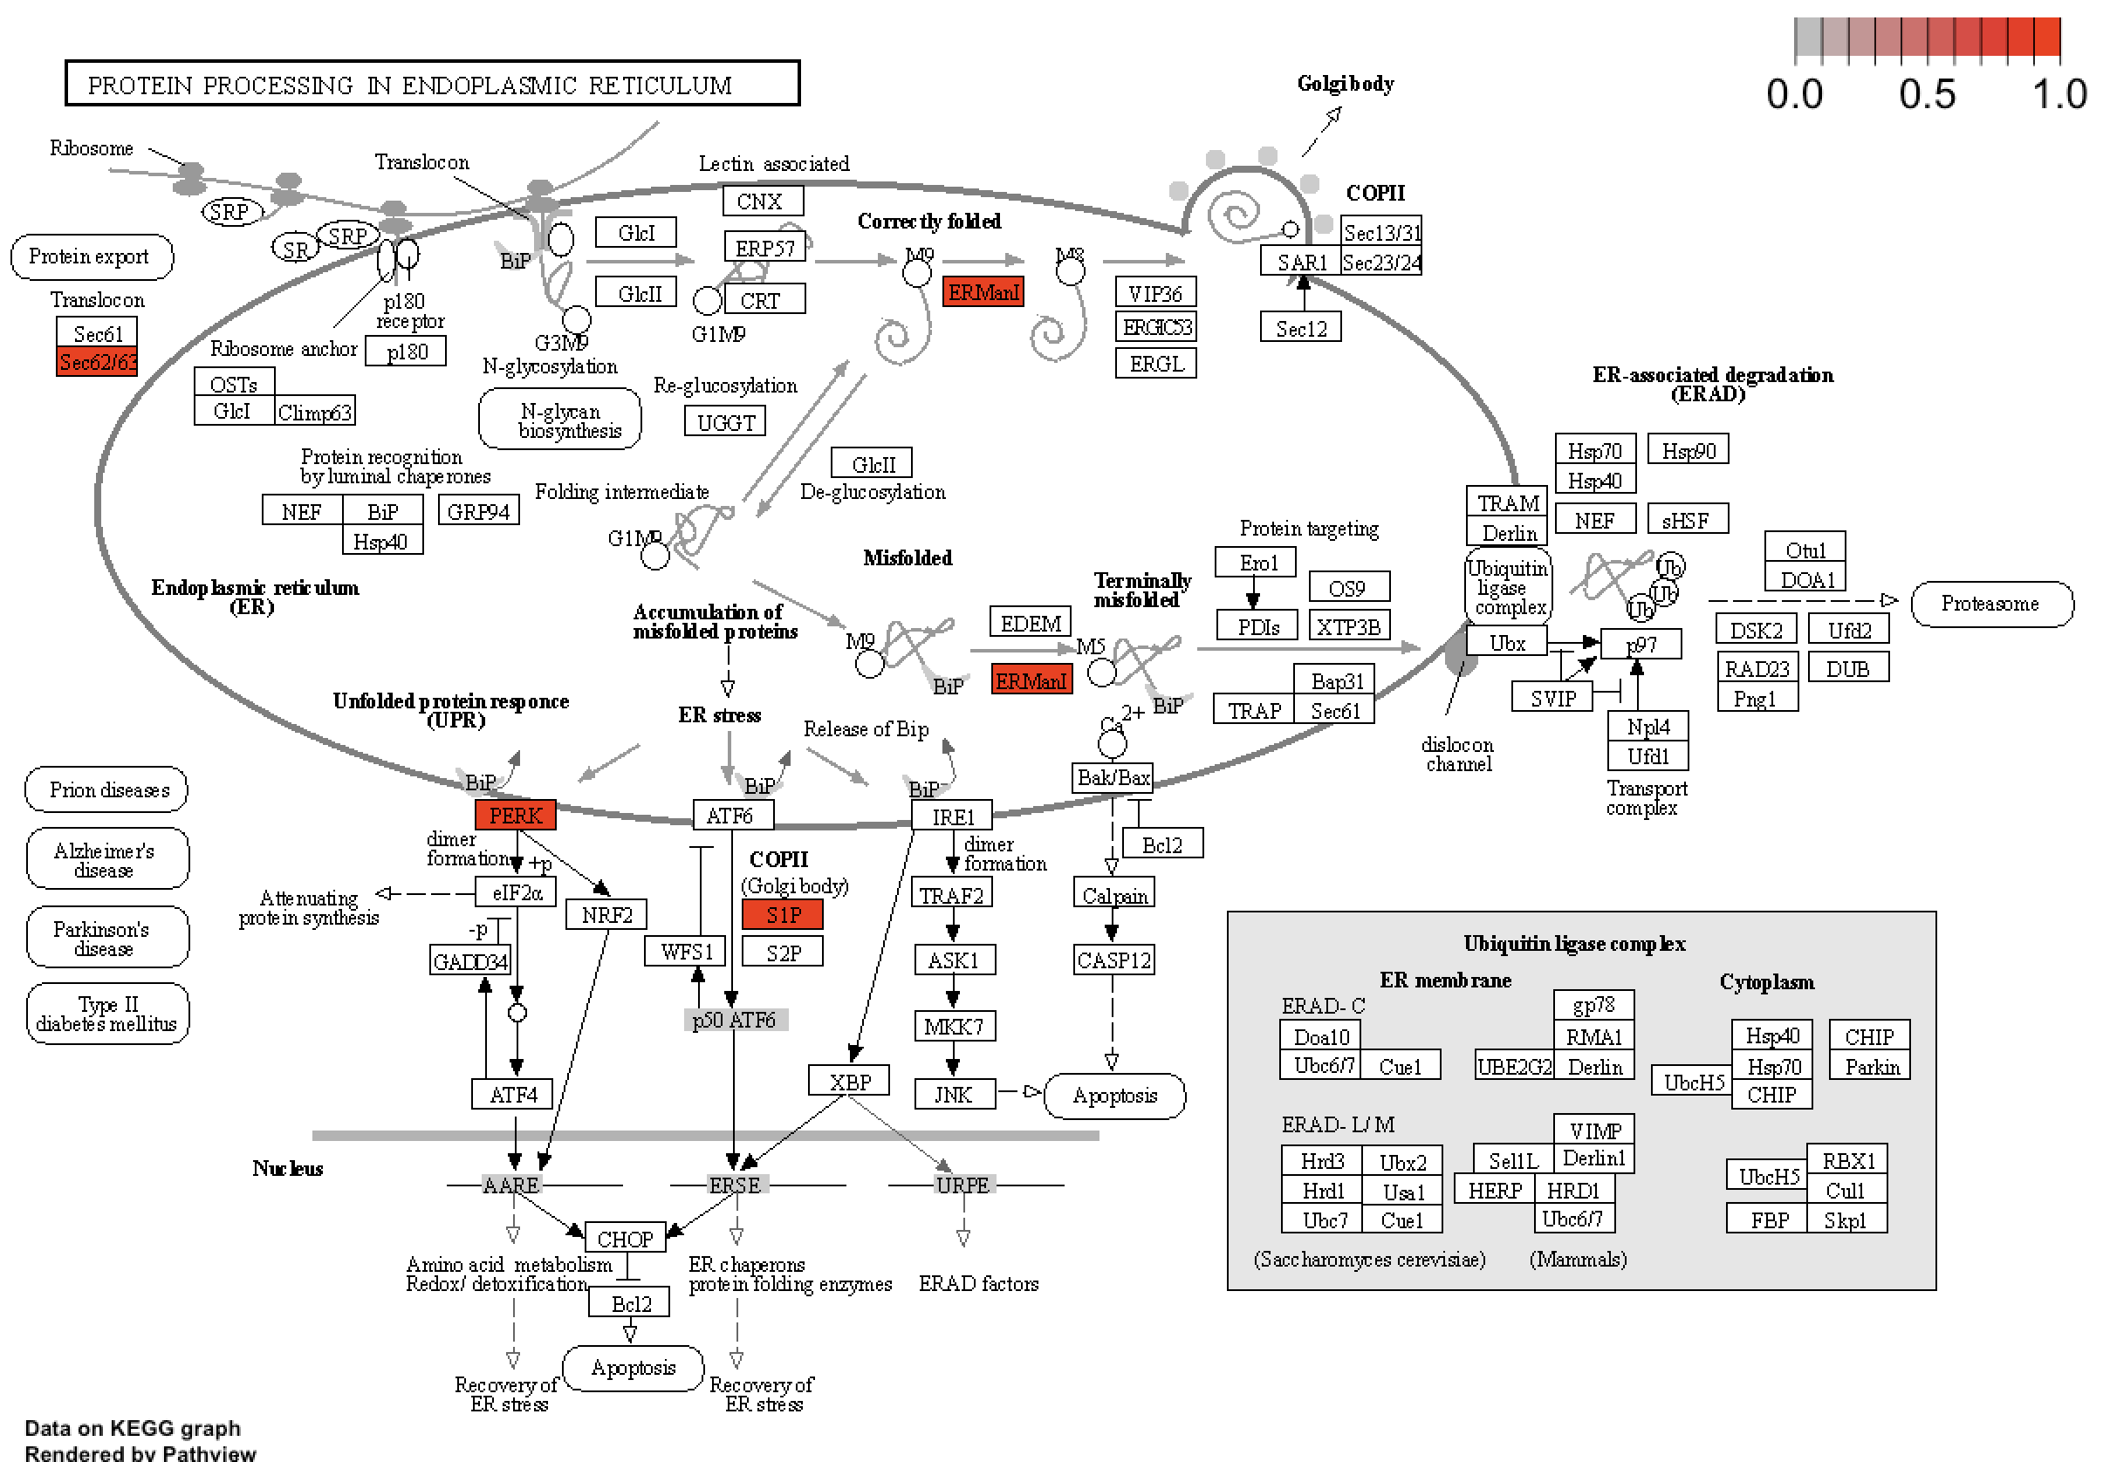
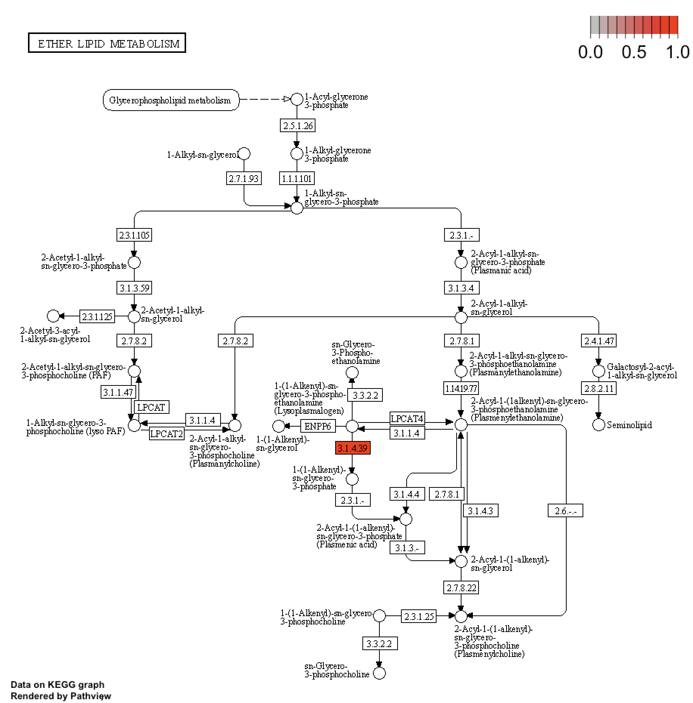
Results: Zonal Week 1 vs Week 2
Cluster Group 1
Cluster Group 2

Slide 18
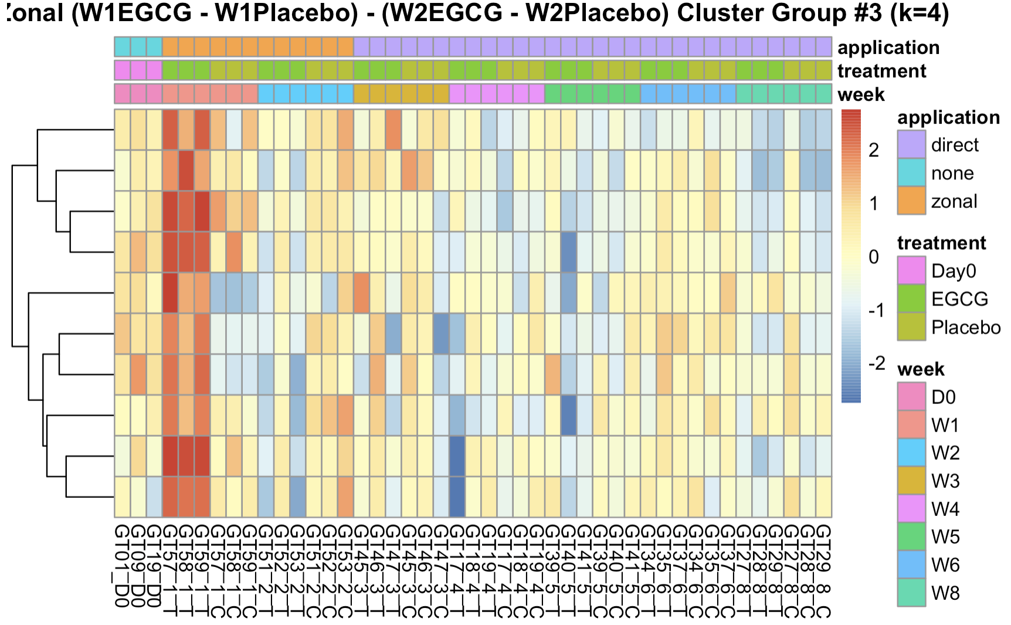
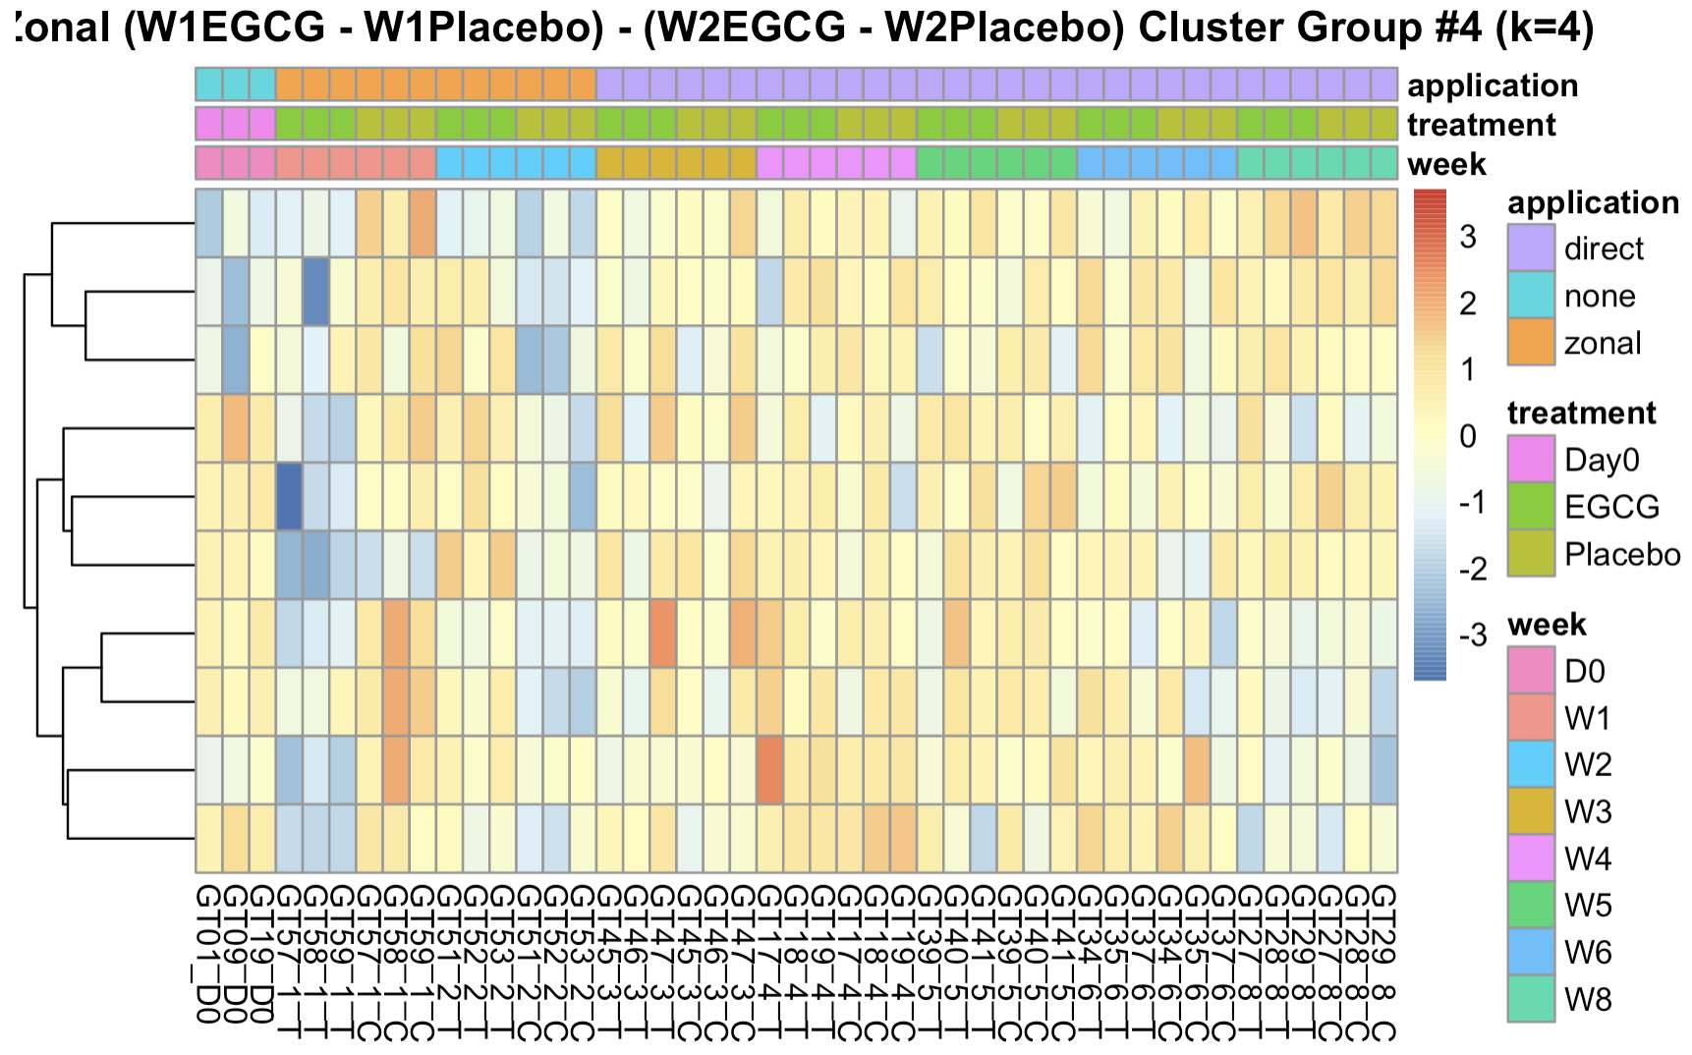
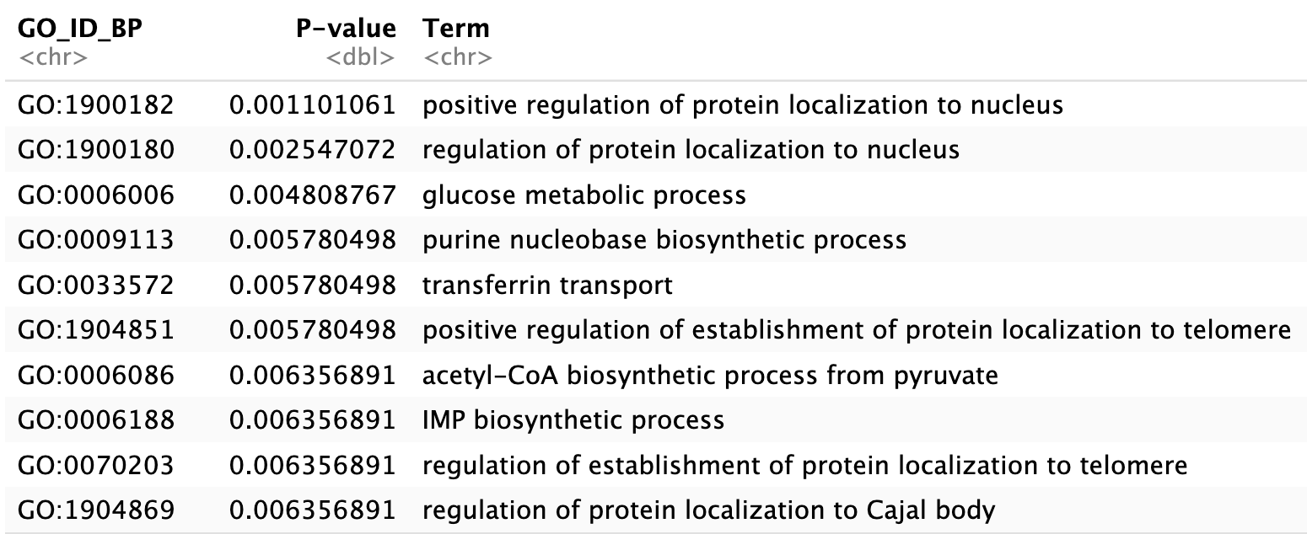
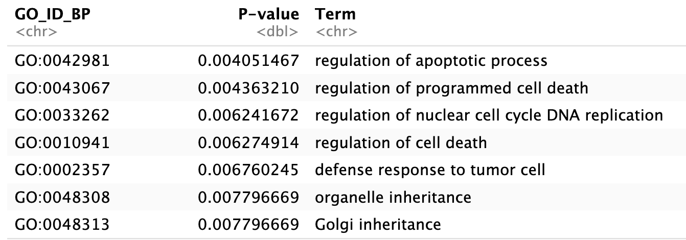
Results: Zonal Week 1 vs Week 2
Heatmaps were generated for each cluster, with associated Go-Term Enrichment analysis for each cluster. These are for Clusters 3 + 4
Localization/ Biosynthesis
Apoptosis/Cell Death

Slide 19
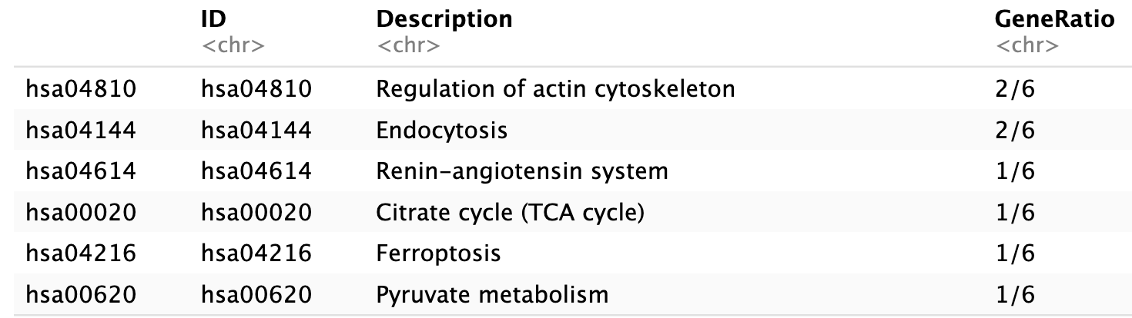
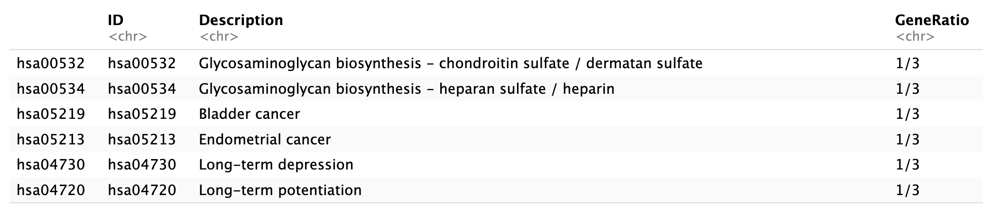
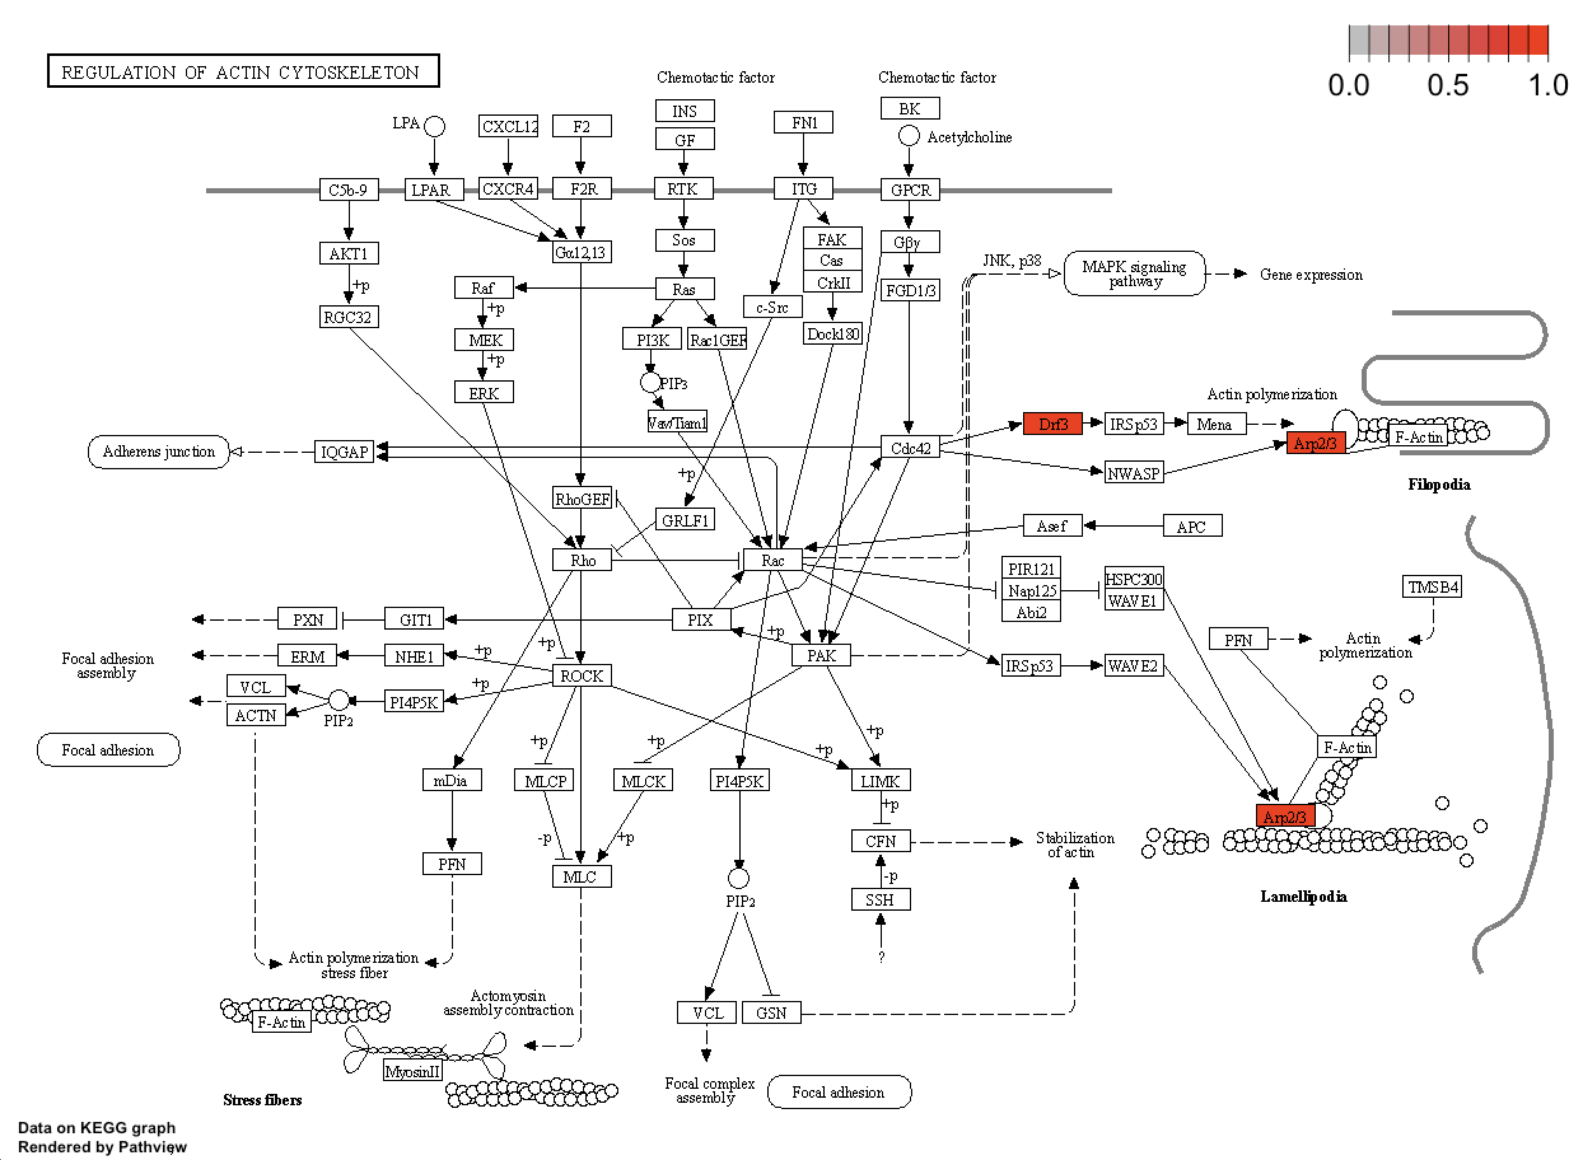
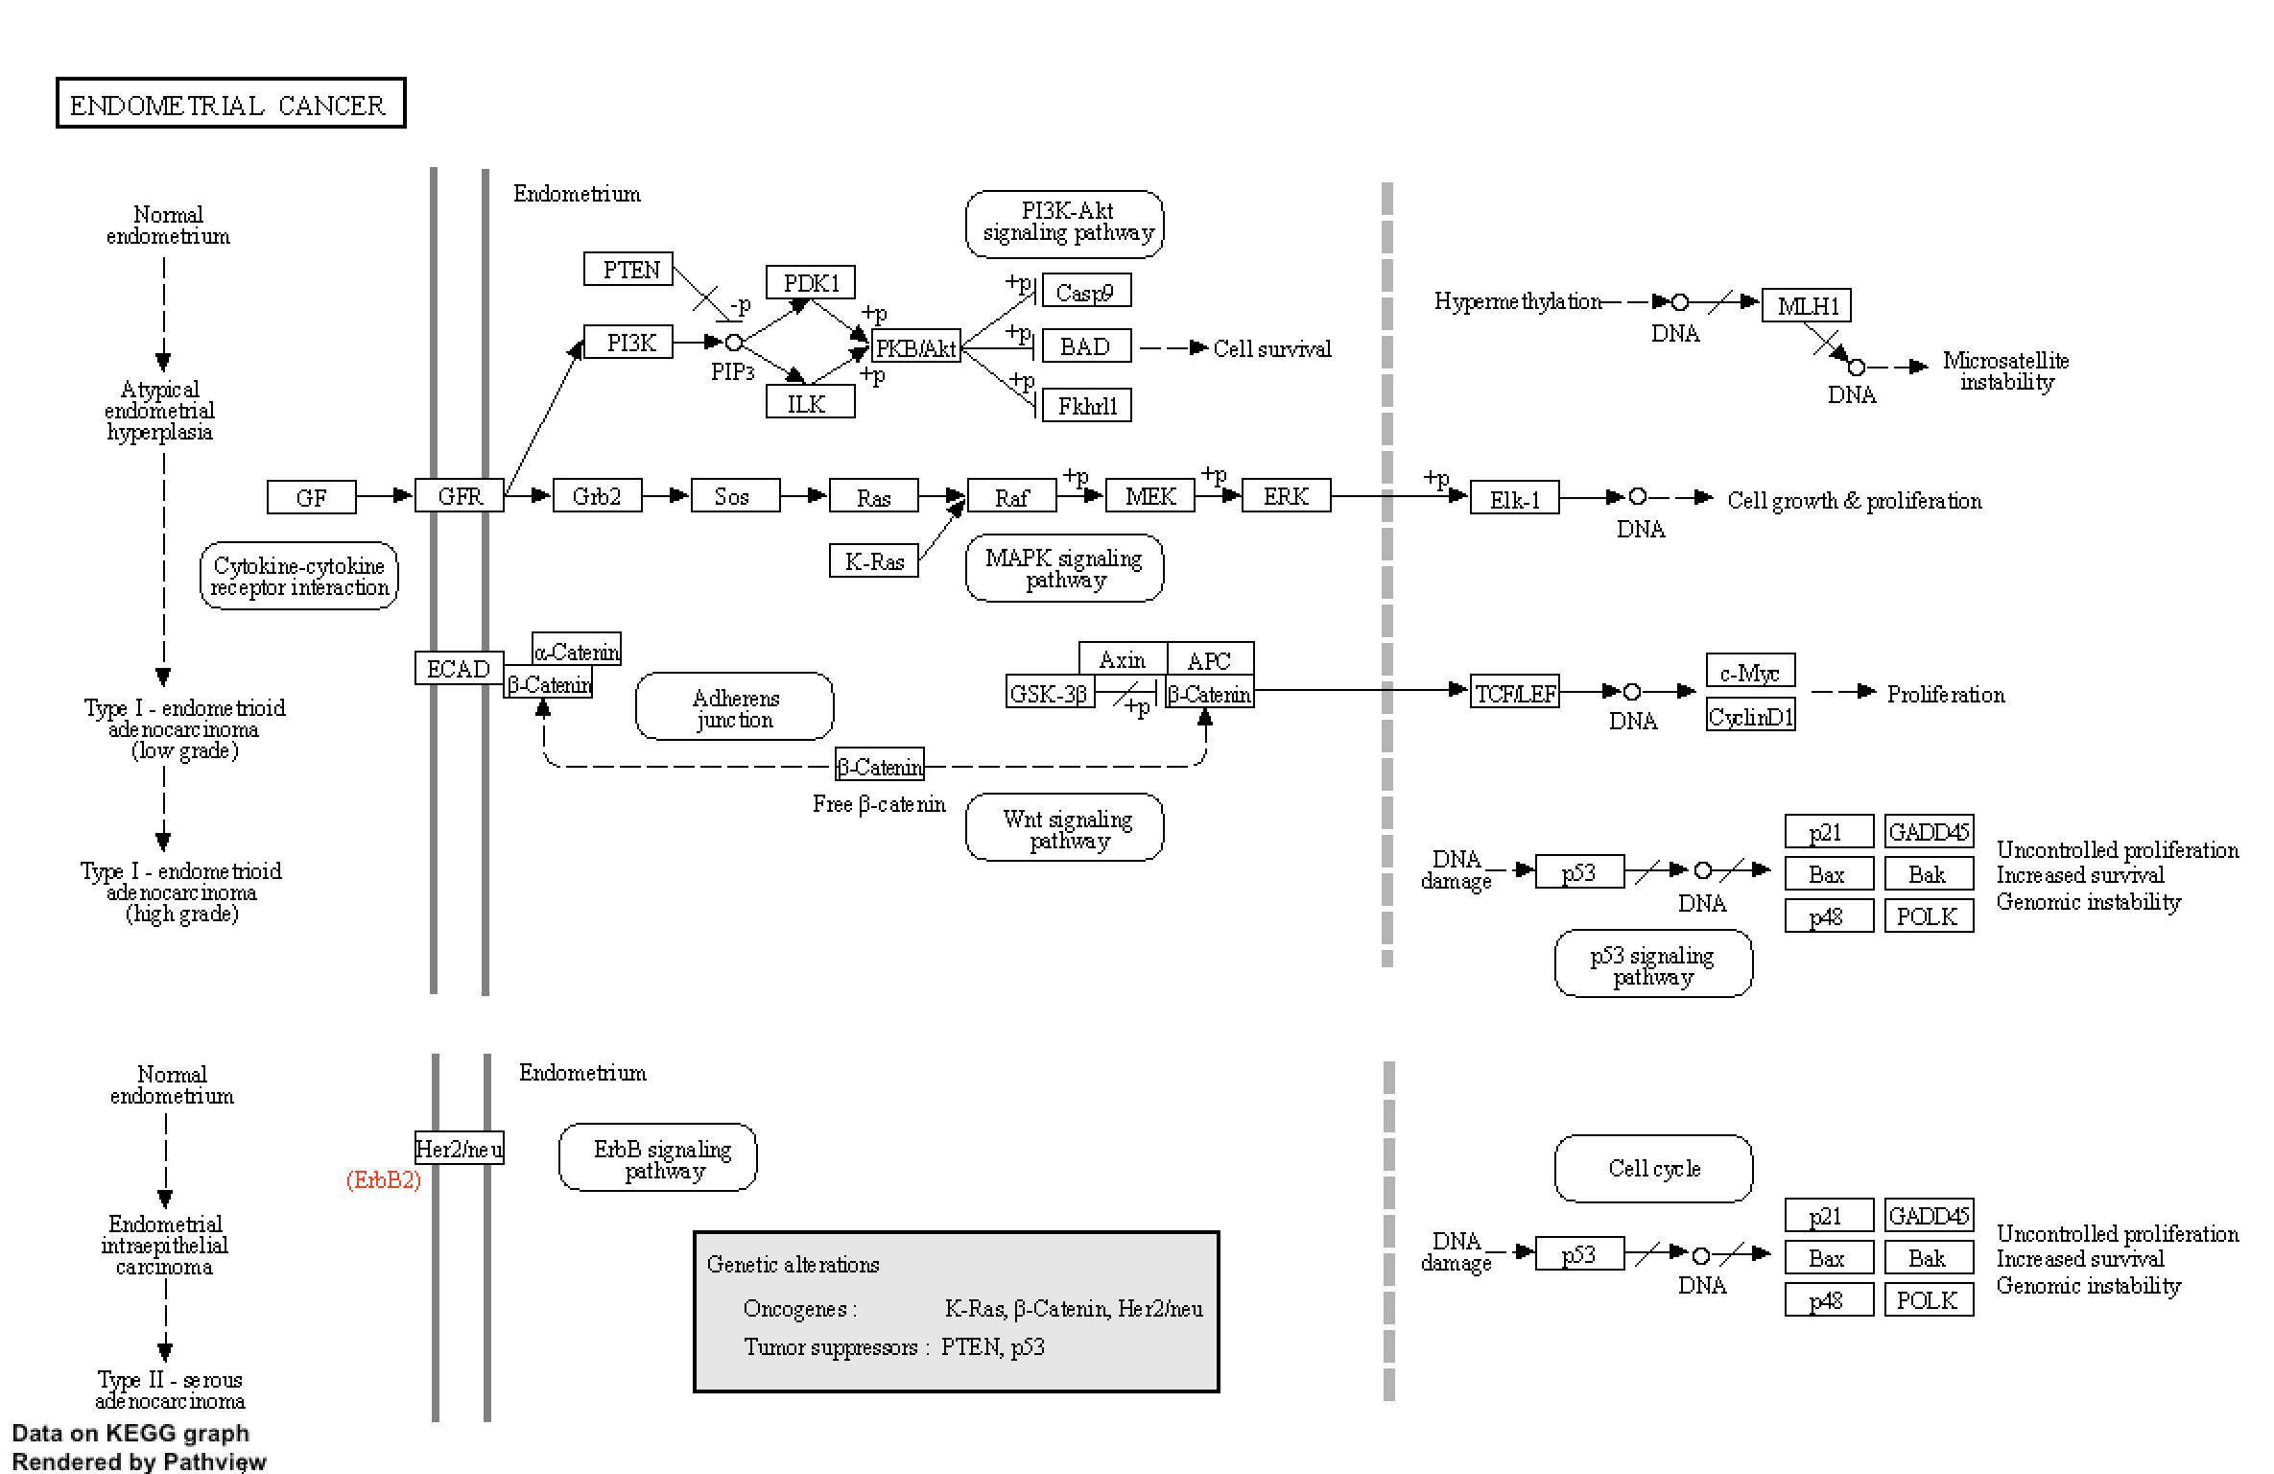
Results: Zonal Week 1 vs Week 2
Cluster Group 3
Cluster Group 4

Slide 20
Results
Three Comparisons:
Week 1 EGCG vs Placebo
Week 1 vs Week 2: Relative to Treatment over time: EGCG Treatment
Week 1 vs Week 2: “Global Change” Week 1 vs Week 2

Slide 21
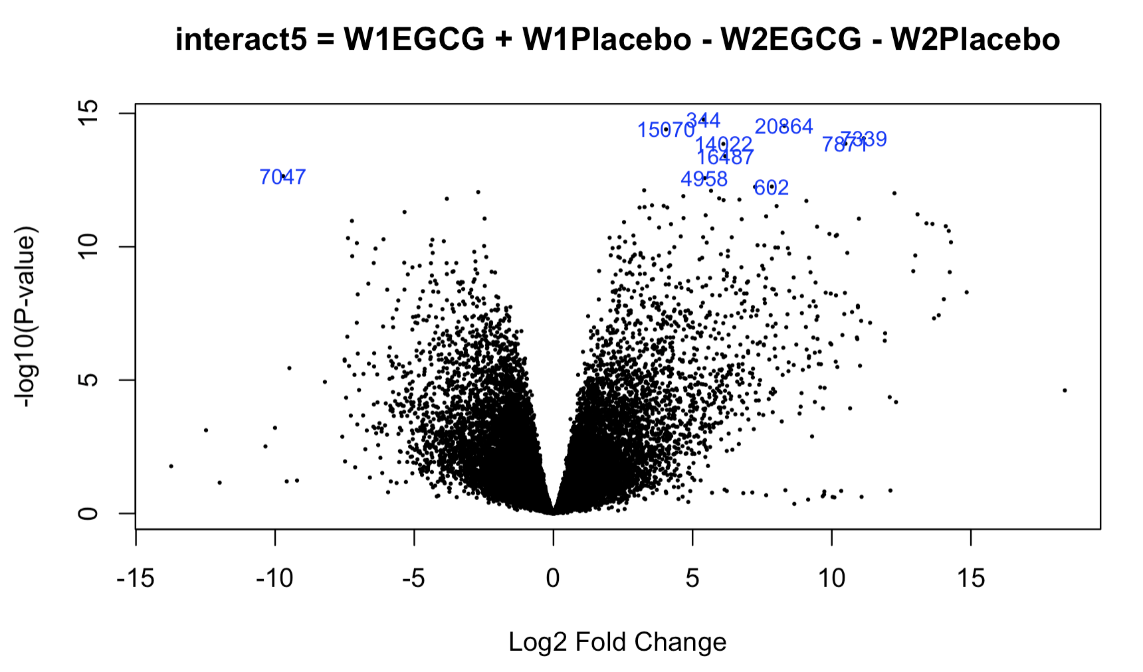
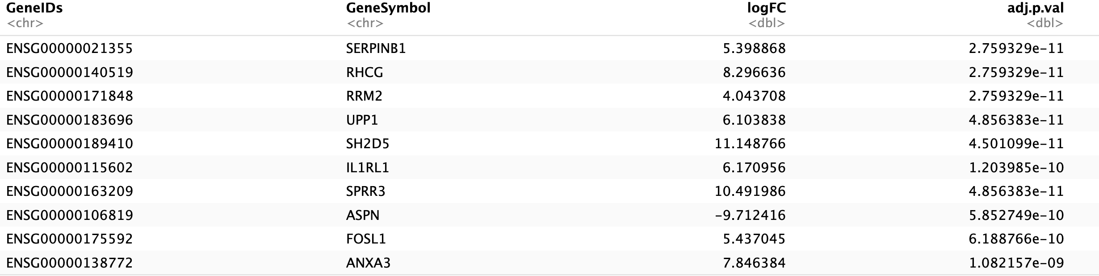
Results: “Interact5” Week 1 vs Week 2 (Global Differential Response)
Below is the Top 10 significantly Differentially Expressed Genes (DEGs) from LIMMA analysis, indicated in the blue reference rownames in the associated Volcano Plot.
Top10 genes involved in: wound healing, inflammation, ECM remodeling + regeneration, cell proliferation and migration. IL1RL1, was captured as being significantly involved with treatment.

Slide 22


Results: “Interact5” Week 1 vs Week 2 (Global Differential Response)
To keep p-value cutoffs for DEG analysis the same between all comparisons, we had to implement a FDR cutoff of 0.2 and a L2FC of 1.5 in order to capture enough significant gene candidates for cluster analysis.
This produced a hierarchical clustering graph that was extremely congested, so a Silhouette plot was utilized to determine ideal clustering selection, which was determined k=4.
K was based on the distance between 3-4, another interesting cluster was seen at position 8.

Slide 23




Results: “Interact5” Week 1 vs Week 2 (Global Differential Response)
Cluster Group 1
Cluster Group 2
Immune / Defense / Stress Response
Neuro components / Structure morphogenesis

Slide 24




Results: “Interact5” Week 1 vs Week 2 (Global Differential Response)
Cluster Group 1
Cluster Group 2

Slide 25




Results: “Interact5” Week 1 vs Week 2 (Global Differential Response)
Cluster Group 3
Cluster Group 4
Collagen Catabolic / Vasculature involvement
ECM remodel + New vasculature development
Neural Cell involvement

Slide 26




Results: “Results: “Interact5” Week 1 vs Week 2 (Global Differential Response)
Cluster Group 3
Cluster Group 4

Slide 27
SUMMARY ALL Results

Slide 28
Summary of Results Effects of EGCG show an effect to processes relevant to Wound Healing:
Week 1 Zonal Treatment EGCG vs Placebo
Top 10 genes are involved in: Immunity, Inflammation, Cytokines, Cytoskeleton, Shape and Motility, Cell division. IL-36A, a cytokine involved in inflammation, was captured by our data, which also was found to be affected by EGCG treatment.
Week 1 vs Week 2: effect of EGCG from week 1 to week 2
4 of the Top 10 genes are common to Week1 EGCG vs Placebo: ACTR2, RDX, ANKRD28, CHAC1. Additional genes related to: Energy, Wound Healing, ECM Remodeling, Protein Translocation..
Go Term Analysis (summarized) | KEGG Pathway (top significant)
Reorganization of cellular components and processes | Actin Cytoskeleton
Immune system and cytokine involvement | Cytokine-Cytokine Receptor interaction
Reproduction – more indicative of cell growth | Glycosphingolipid Biosynthesis
Aminoglycans skin ECM components, ECM Remodeling, cellular adhesion | Cell Adhesion Molecules
Go Term Analysis (summarized) | KEGG Pathway (top significant)
Cellular and Protein Localization | Protein Processing in Endoplasmic Reticulum
Sustained immune involvement and catabolic processes in regards to protein and metabolism | Ether Lipid Metabolism / Glutathione Metabolism
Protein localization, nuclear-centric | Regulation of Actin Cytoskeleton
Cell Death, Apoptosis, Cell cycle | Endometrial Cancer*

Slide 29


Summary of Results
Week 1 Week 2 Global Differential Pattern:
Top10 genes had the highest fold change values, and genes were involved in: wound healing, inflammation, ECM remodeling + regeneration, cell proliferation and migration. Captured IL1RL1, a gene involved in inflammation, also identified as an expressed target in related to treatment with EGCG.
Go Term Analysis (summarized) | KEGG Pathway (top significant)
immune, inflammation, biotic stimulus, stress, and defense responses | Viral protein interactor with cytokine and cytokine receptor
Neurogenesis nervous system development, organismal development, morphogenesis | Axon Guidance
Astrocyte & Glial cell differentiation & genesis | Jak-Stat Signaling Pathway
Cytolysis, collagen catabolysis, vasculature development | Complement and coagulation cascades
Notes:
Li M, Knapp SK, Iden S. Mechanisms of melanocyte polarity and differentiation: What can we learn from other neuroectoderm-derived lineages? Curr Opin Cell Biol. 2020;67:99-108. doi: https://doi.org/10.1016/j.ceb.2020.09.001.

Slide 30
Results Comparison to Paper
Analysis “Contrasts” | Paper Analysis | Our Analysis | Notes:
Week 1 | Mast Cell, angiogenic, inflammatory, and antioxidant genes were significantly down-regulated with EGCG significant down-regulation of immune system processes and response, tumor necrosis factor receptors, and cytokine binding in (EGCG) samples compared with placebo. | Confirmed reduction in genes involved in immunity and inflammation with IL1RL1, IL36A, also detected, We identified additional genes related to structure, differentiation, and motility. Confirmed down regulation of immune system responses and processes in cluster group#2 Cytokine Binding was a significant KEGG Pathway also found in cluster group#2
Week 2 (Week 1 – Week 2) | M2 macrophage numbers were increased with EGCG Other time points did not show any significance Down-regulation in epidermis development in EGCG samples compared with placebo. | Our gene data is contrary to this observation, however increased transcript activity sometimes does not correspond to measured protein levels or cell population numbers We also found that all other time points were not significant, from week 2-week 6. | Comparison of our Global analysis of the difference of Week 1 to Week 2, also revealed an increase in genes related to “Collagen Catabolic Processes” in cluster group#4
Direct Treatment (Global Week 1- Week 2) | EGCG down-regulated angiogenesis and vessel density with Direct treatment | Direct treatment was not significant, therefore we did not continue analysis with comparisons. | However, we were able to confirm that our data in Cluster 4 with comparing global trends in expression from Week 1 – Week 2, confirms vasculature development, it may be plausible, given our data

